Slide 1
Third Level Engineering Provision in the Midlands Dr Seán Lyons

Slide 2
Overview
TUS offers a range of Engineering & apprenticeship programmes across the Midlands and Midwest regions
The Midlands Faculty of Engineering & Informatics has significantly increased student numbers in recent years in response to regional demand.

Slide 3
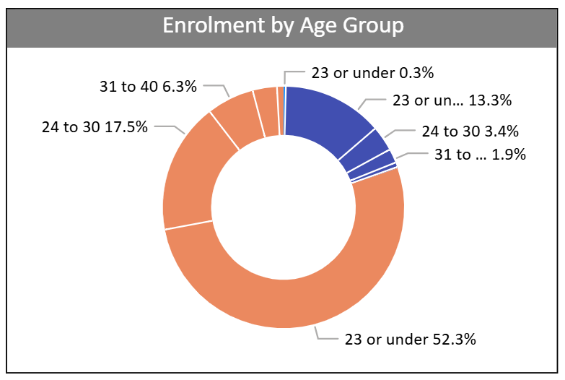
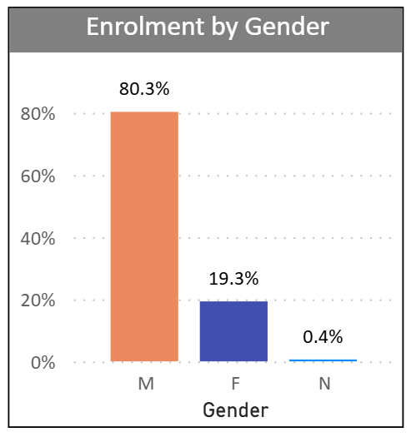
Engineering Student Demographics

Slide 4
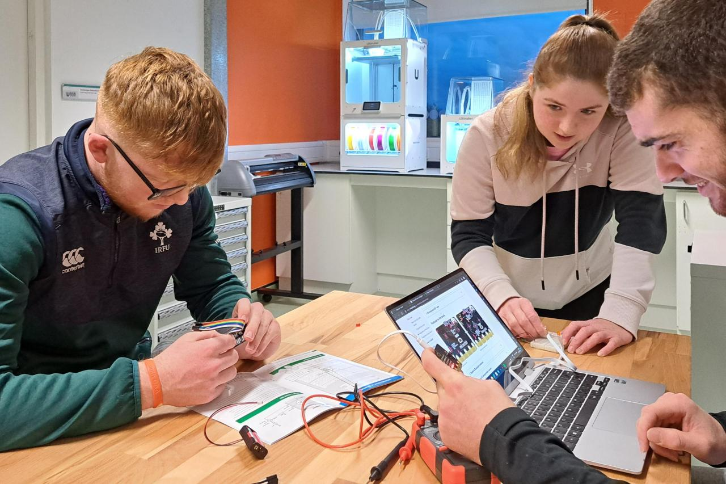
Department of Technology Education
Level 9
Technology Education (by Research)
Level 8
BEd in Technology, Engineering and Graphics - (Post-Primary)
Level 6
Access Programme
BEng Design Engineering

Slide 5
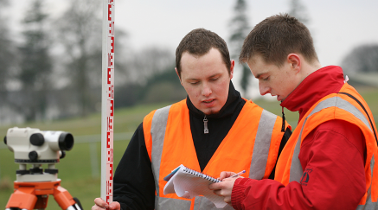
Department of Civil Engineering & Trades
Level 9
Master of Engineering in Engineering Management
Master of Engineering in Energy Infrastructure
Master of Engineering in Environmental Infrastructure
Level 8
Bachelor of Engineering in Civil Engineering
Bachelor of Engineering in Construction Management
Bachelor of Science in Quantity Surveying
Higher Diploma in Construction Data Capture & Analytics
Higher Diploma in BIM for Civil Engineering & Construction
Level 7
Bachelor of Engineering in Civil Engineering

Slide 6
Current Craft Apprentice delivery
2024/2025 allocation will represent growth of 74% in craft apprenticeship students over 2021/2022

Slide 7
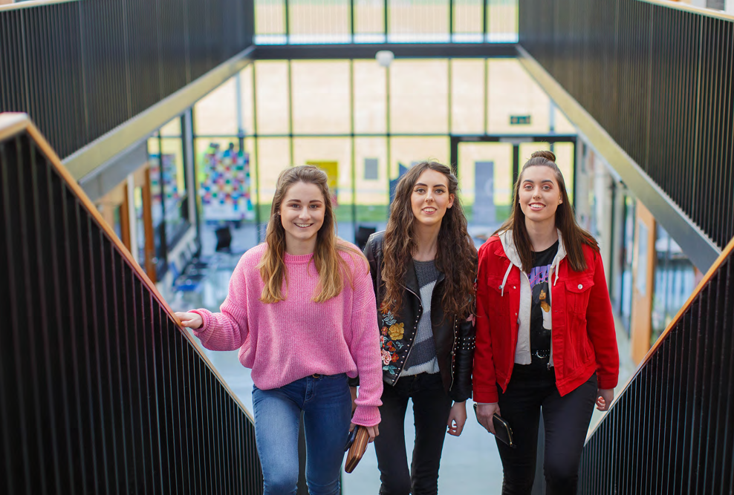
Department of Mechanical & Polymer
Level 9
Master of Science in Advanced Polymer Materials
Level 8
Automation & Robotics
Mechanical Engineering with Energy
Mechanical Engineering
Mechanical & Polymer Engineering
Level 7
Automation & Robotics
Mechanical Engineering with Energy
Mechanical Engineering
Mechanical & Polymer Engineering
Polymer Technologist (apprenticeship through IBEC)

Slide 8
Department of Computer & Software Engineering
Level 8
Software Design With Virtual Reality and Gaming
Software Design With Artificial Intelligence & Cloud Computing
Level 7
Software Design With Virtual Reality and Gaming
Level 6
Software Design
Computer Engineering
Software Design With Digitalisation
Computer Engineering With Network Infrastructure
Computer Engineering for Autonomous Systems
Software Design With Artificial Intelligence & Cloud Computing
Software Design With Digitalisation
Computer Engineering
Computer Engineering With Network Infrastructure
640 Students currently completing Undergraduate programmes
All level 8 programmes contain Industrial Placements (3rd Year) & Industrially applied projects
Progression routes from ETBs as well as CAO

Slide 9
Computer Engineering
Software Design with Virtual Reality and Gaming
Computer Engineering for Robotics
.
Software Design with Artificial Intelligence for Cloud Computing
Department of Computer and Software Engineering
Computer Engineering for Network Infrastructure
Software Design with Digitalisation

Slide 10
Design Engineering
Building Information Modelling
Data Capture for Construction
.
Engineering Management
ICT Programmes
Automation & Robotics
.
Mechanical Engineering

Slide 11
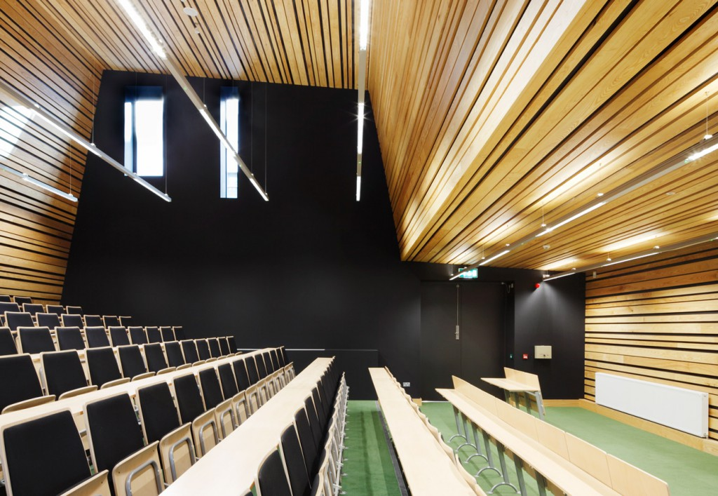
Engineering Taught Postgraduate Strategy
90 Credit
Taught MSc in Software Design
Research Dissertation
(30 Credits)
Work Placement (30 Credits)
The taught masters programmes implemented by the Faculty of Engineering & Informatics follow a similar structure, developed to ensure flexible, agile provision and progression opportunities for learners.
Applied Modules (30 Credits)
Semester 1/Semester 2
10 credit Module
5 Credit Module
Common Core (30 Credits)
Research Methods & Professional Practice
Engineering Team Project
Object Oriented Design I & II

Slide 12
Engineering Taught Postgraduate Strategy
Research Dissertation
(30 Credits)
Work Placement (30 Credits)
Applied Modules (30 Credits)
Semester 1/Semester 2
10 credit Module
5 Credit Module
30 Credit
Taught Postgraduate Certificate
Common Core (30 Credits)
Research Methods & Professional Practice
Engineering Team Project
Object Oriented Design I & II
30 Credit
Taught Postgraduate Certificate

Slide 13
Engineering Taught Postgraduate Strategy
Research Dissertation
(30 Credits)
Work Placement (30 Credits)
Applied Modules (30 Credits)
Semester 1/Semester 2
10 credit Module
5 Credit Module
60 Credit
Taught Postgraduate Diploma
Common Core (30 Credits)
Research Methods & Professional Practice
Engineering Team Project
Object Oriented Design I & II

Slide 14
MSc in Software Design with AI
MSc in Software Design with Cloud Native Computing
MSc in Software Design with Cybersecurity
MSc in Software Design with Digitalisation
Research Dissertation
(30 Credits)
Work Placement (30 Credits)
Research Dissertation
(30 Credits)
Work Placement (30 Credits)
Research Dissertation
(30 Credits)
Work Placement (30 Credits)
Research Dissertation
(30 Credits)
Work Placement (30 Credits)
Applied Modules (30 Credits)
Applied Scripting
Data Mining and Machine Learning
Advanced Machine Learning and Neural Networks
Data Visualisation
Applied Modules (30 Credits)
Applied Scripting
Container Design and Deployment
Continuous Build and Delivery
Microservices Architecture
Applied Modules (30 Credits)
Security in the Enterprise
Device Security
Network Security
Cryptography
Applied Modules (30 Credits)
Applied Scripting
Data Mining and Machine Learning
Digitalisation Strategies for Industry 4.0
Digitalisation System Architecture
Common Core (30 Credits)
Research Methods & Professional Practice
Engineering Team Project
Object Oriented Design I & II
Common Core (30 Credits)
Research Methods & Professional Practice
Engineering Team Project
Object Oriented Design I & II
Common Core (30 Credits)
Research Methods & Professional Practice
Engineering Team Project
Object Oriented Design I & II
Common Core (30 Credits)
Research Methods & Professional Practice
Engineering Team Project
Object Oriented Design I & II

Slide 15
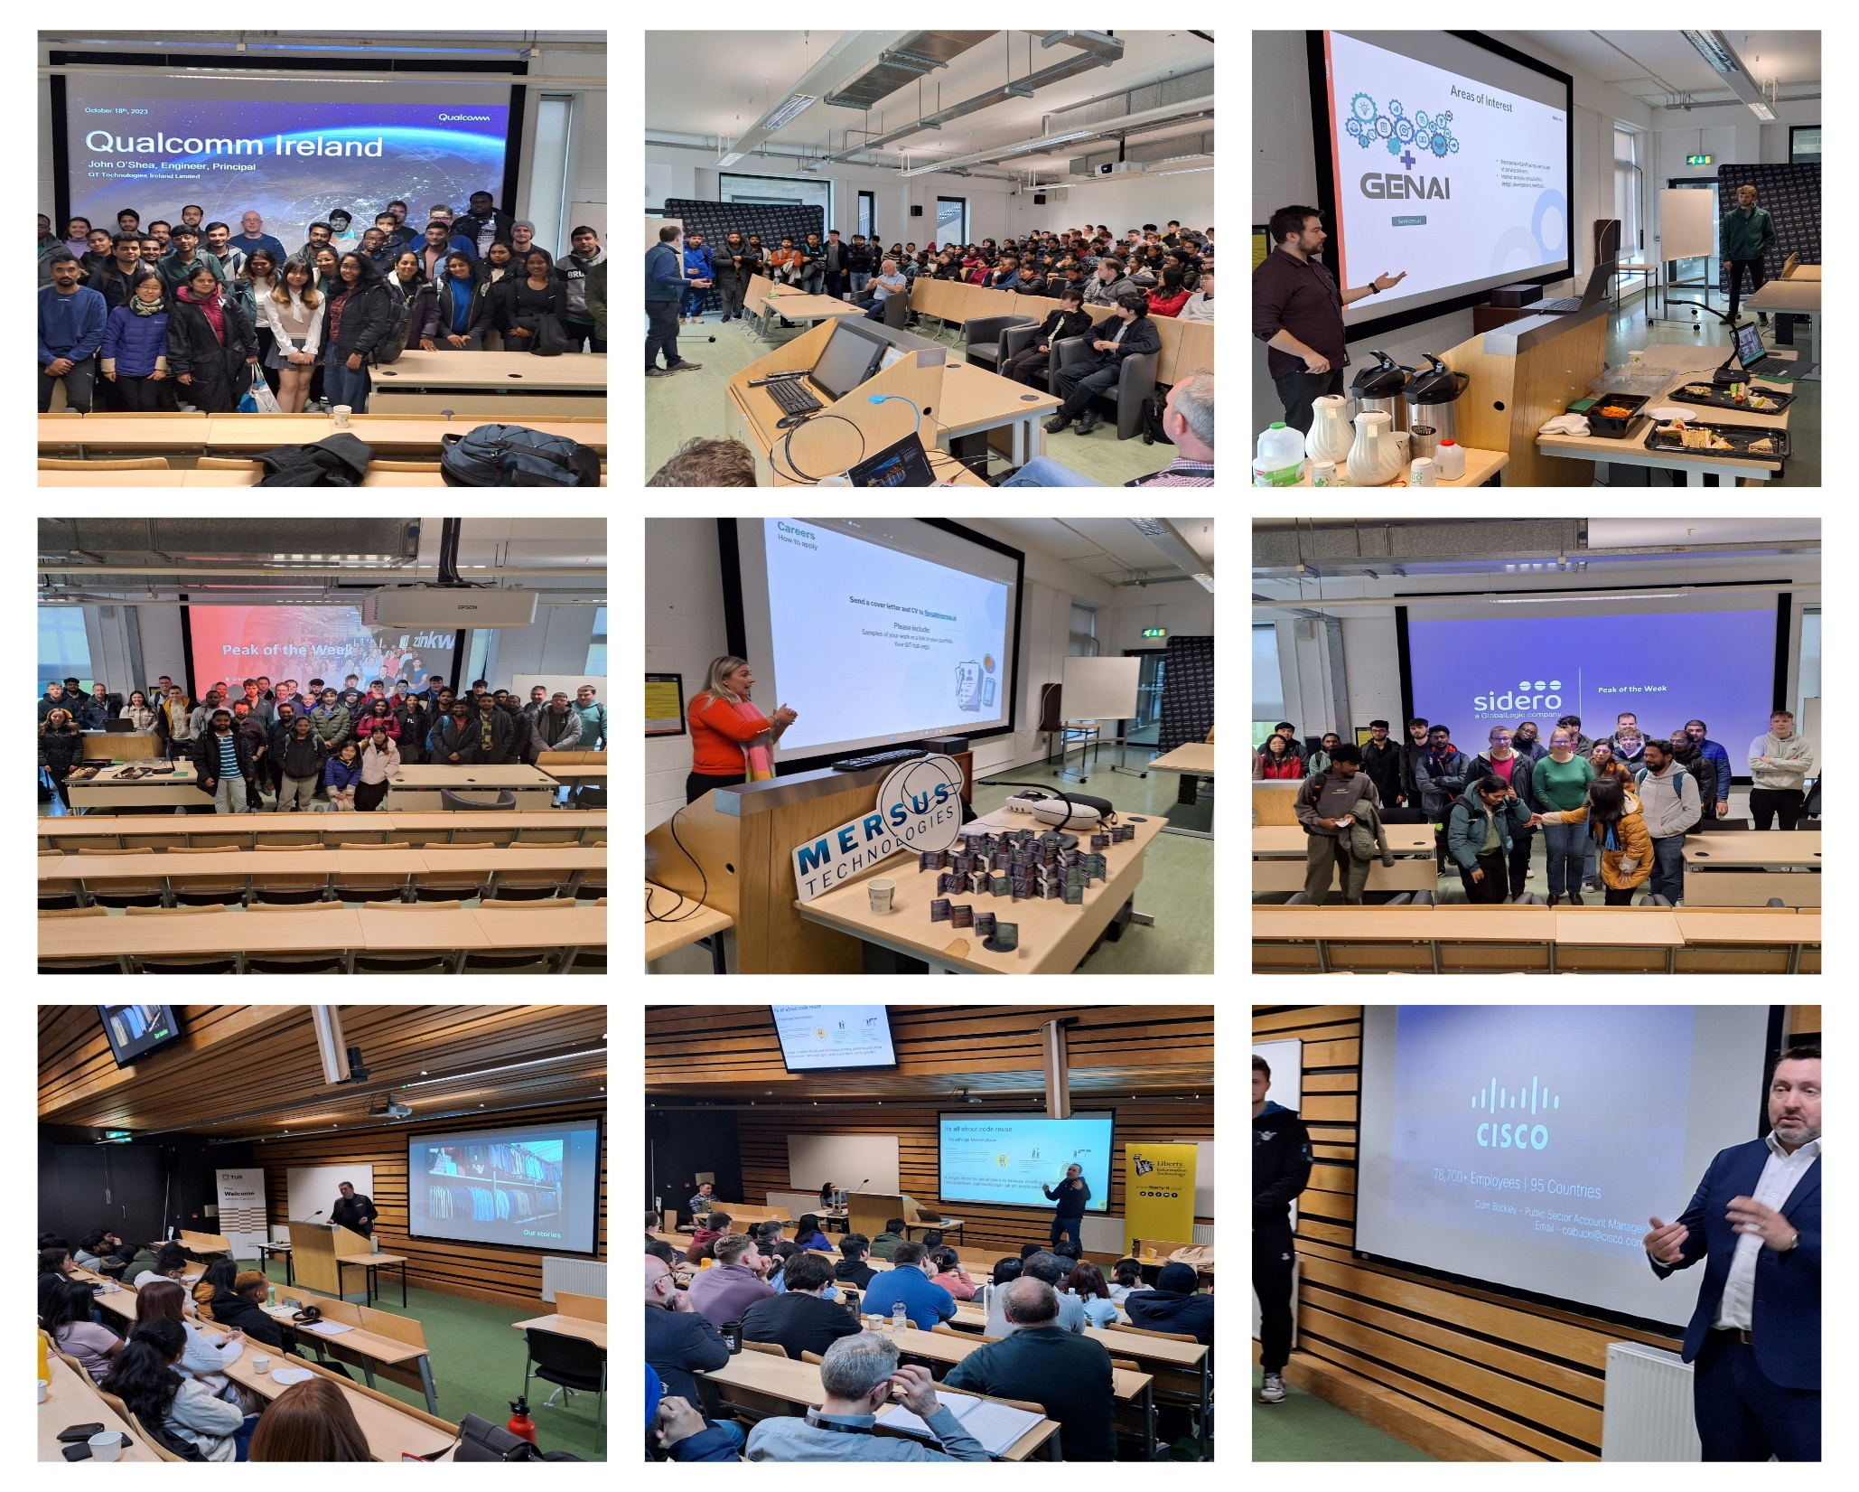
Peak of the Week
Lecture Series

Slide 16
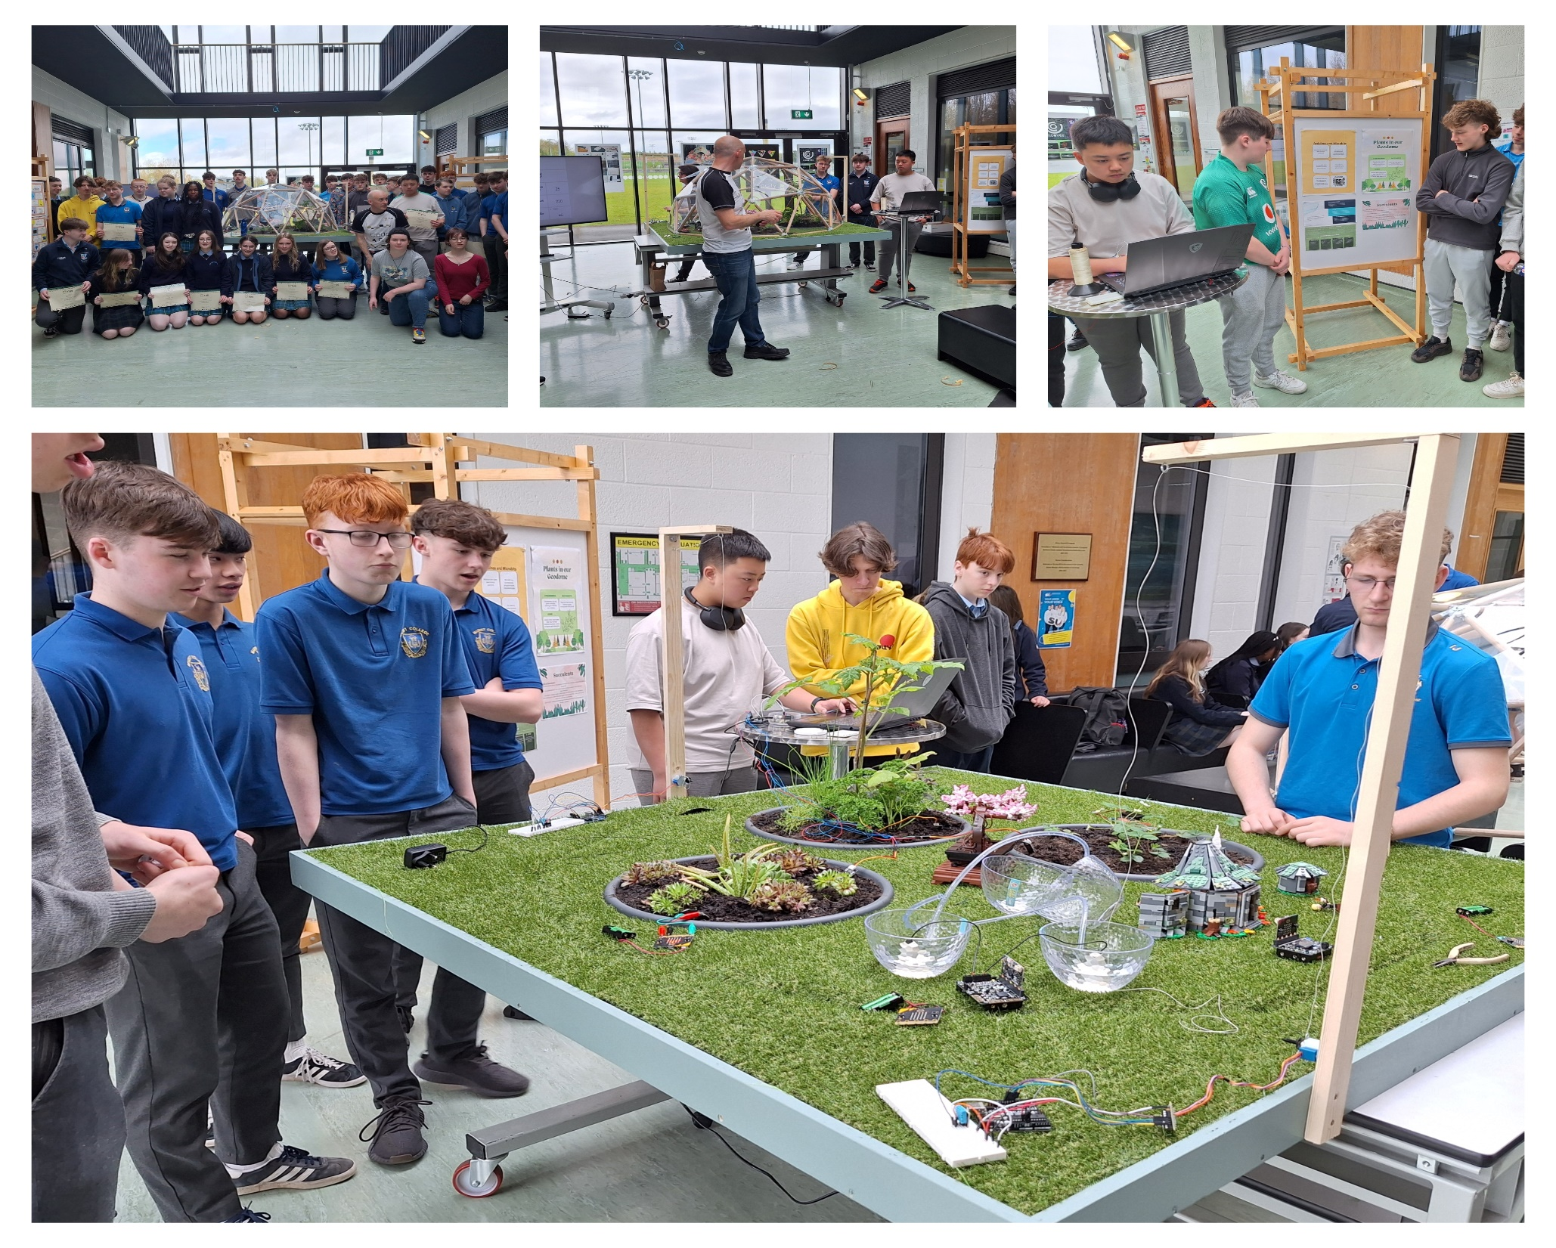
Code 4 Fun
TY Series

Slide 17
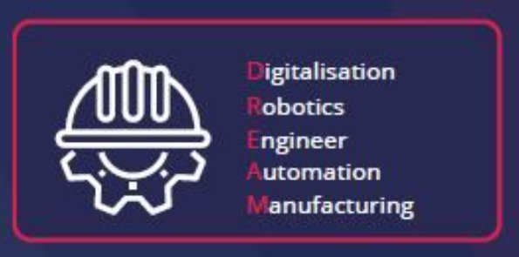
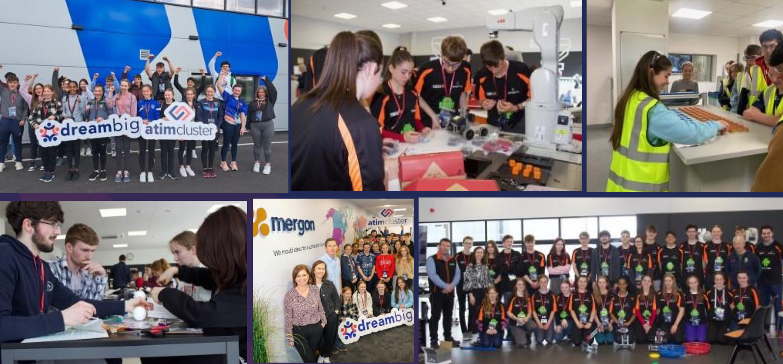
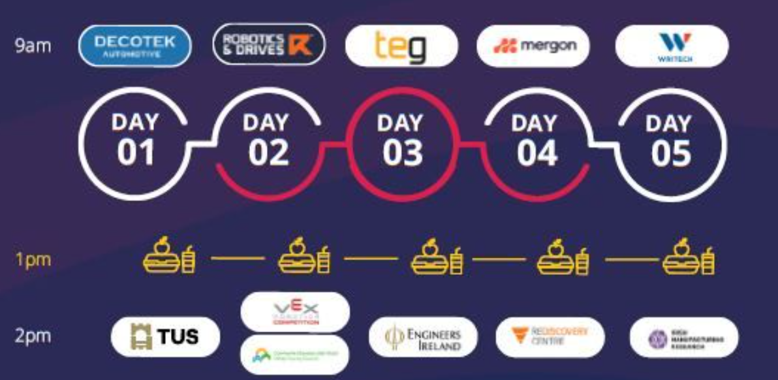
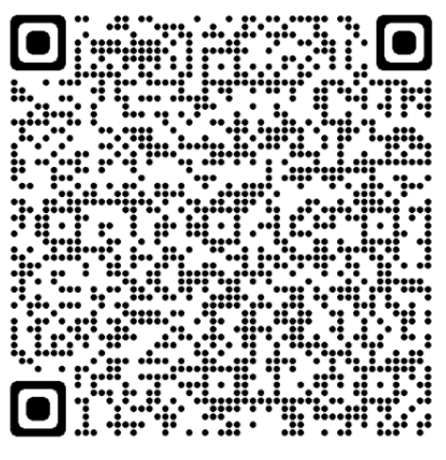
DreamBIG Series
92% of participants agreed that the programme improved their problem solving skills
100% of participants agreed that the programme met its objective: to inspire, engage and support them pursue a career in advanced manufacturing
92% agreed or strongly agreed that they improved their communication and presentation skills
66% said they would like to work in engineering or manufacturing in the future
100% of students felt the programme positively influenced their career choice, with 72% stating that it has given them a better understanding of the variety of career opportunities in the manufacturing sector

Slide 18
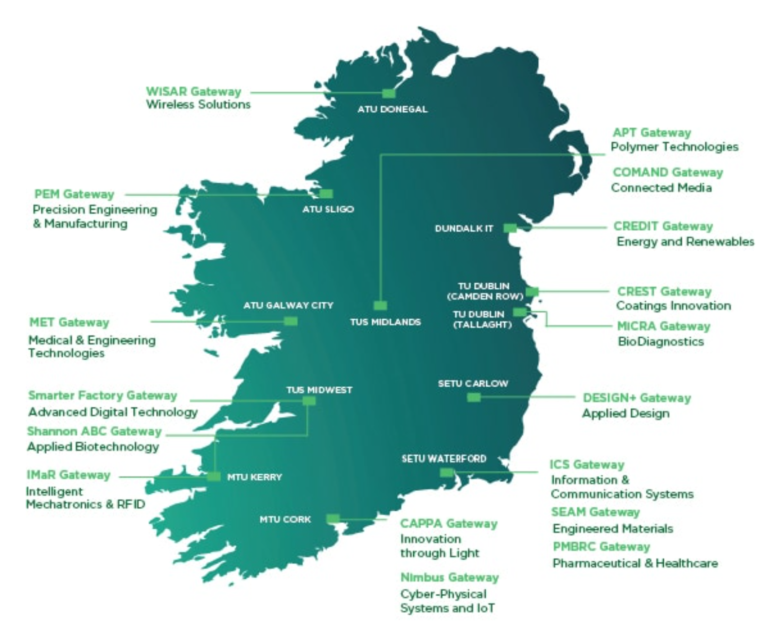
Each centre works in conjunction with industry to aid the research and development of innovative products and services through a dedicated team of full-time researchers and engineers.

Slide 19
#EUinmyregion
The Applied Polymer Technologies Gateway (APT) is co-funded by the Government of Ireland and the European Union through the ERDF Southern, Eastern & Midland Regional Programme 2021-27

Slide 20
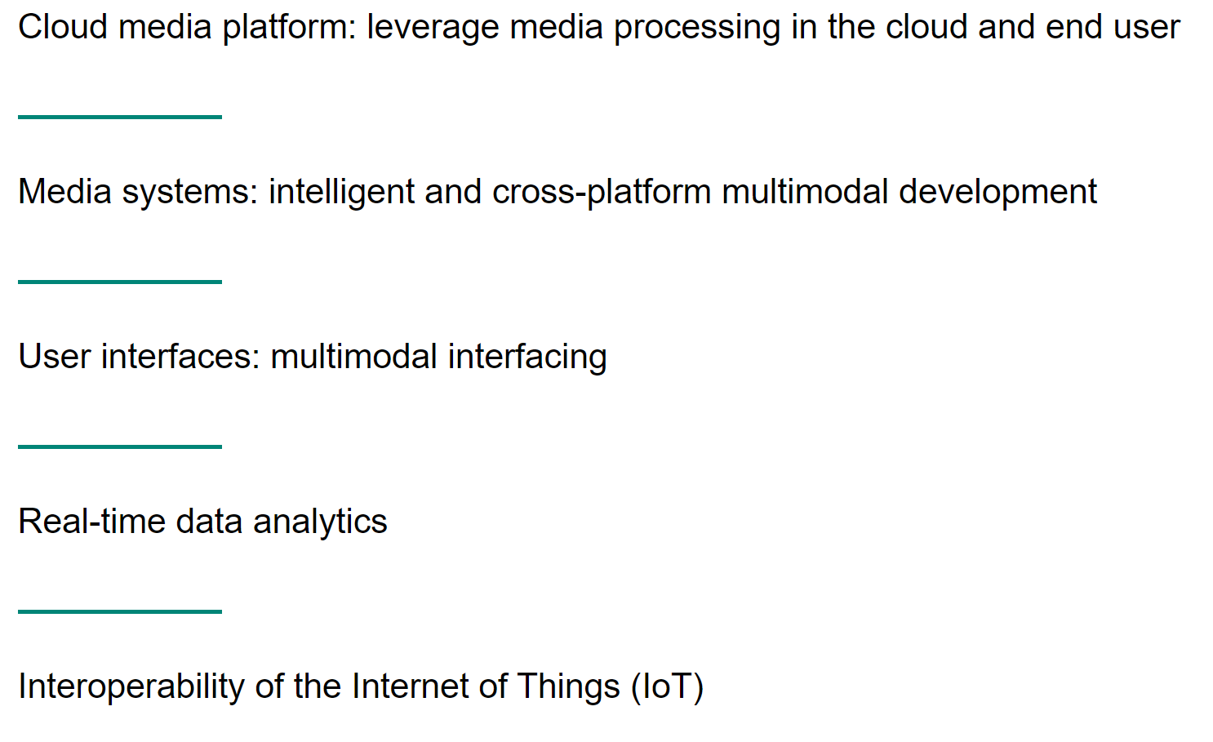
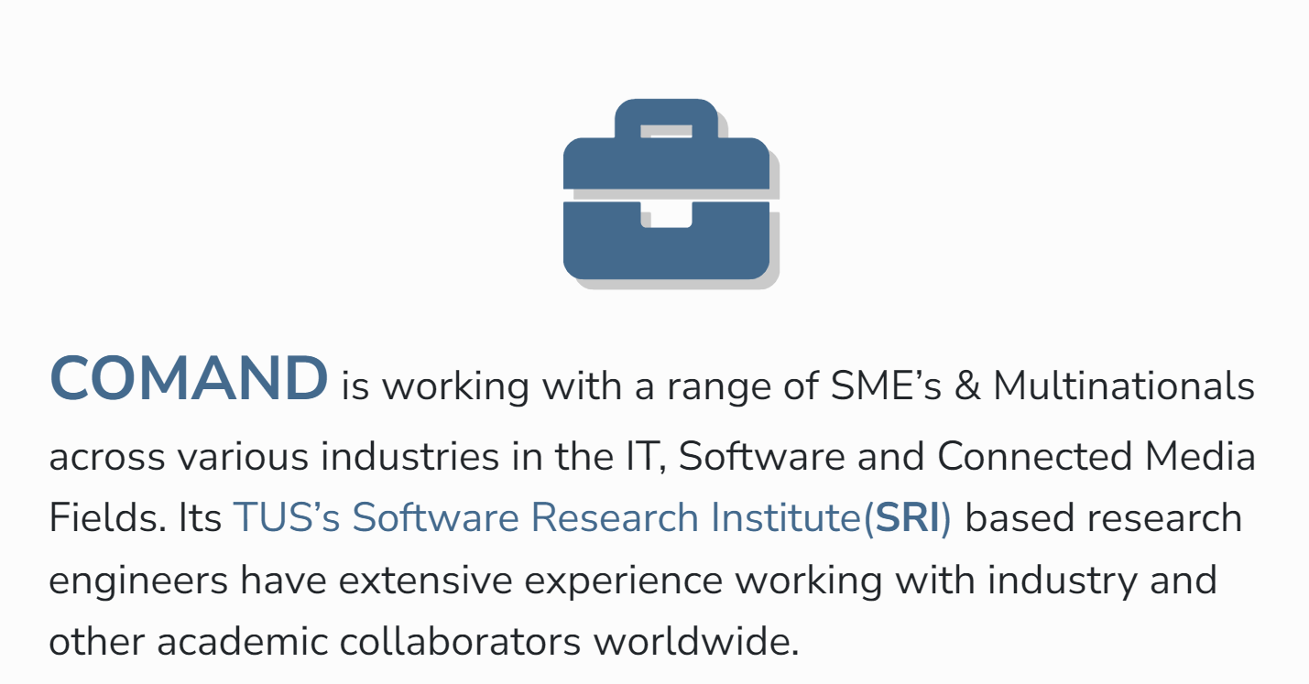

Slide 22
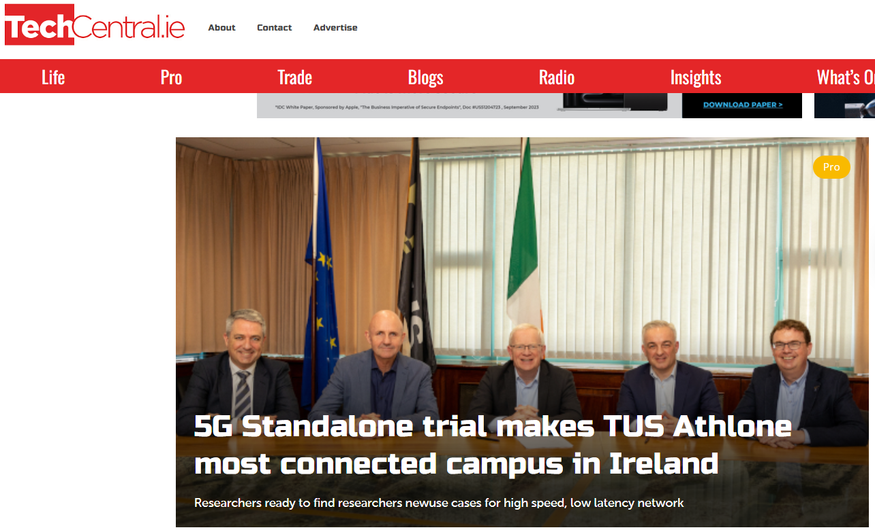
TUS 3 Mobile and Ericsson
Deploy 5G Standalone Mobile Network

Slide 23
Faculty of Engineering & Informatics Industrial Engagement Examples
Thank you sean.lyons@tus.ie

