Slide 1
The COMAND Technology Gateway is co-funded by the Government of Ireland and the European Union through the ERDF Southern, Eastern & Midland Regional Programme 2021-27

Slide 2
Innovation Partnerships
IDASO IPP Mullingar based , Computer Vision Research & Implementing solutions for Traffic Management
Writech IPP Using AI & Machine learning to enhance Automated pipe cutting/ Measurements
Zincworks IPP Telecoms – Automation of Mgmt Systems.
Mergon Robotic Solutions based on imitation learning.
VEI Voice Engineer Ireland IPV6
Tunstall / Emergency Response : Patient Fall prediction
Ericsson Digital Twin Mmanagement Systems
Direct Contract Design with Ericsson Open Source
Direct Contract Design with Circana, Data Analytics

Slide 3
,
H20:20 Project Funding Achieved: ResilMesh: Situation Aware enabled Cyber Resilience for Dispersed, Heterogenous Cyber Systems The total budget allocated to TUS is €1,405,000

Slide 4
Innovation Voucher : 10K per voucher
 | Research a mobile application for iOS and Android, with integrated components of the platform to utilise PayPal, Revolut and Stripe.
Create a project manager software application which will consist of a mobile application and a backend API.
Database work, application design, proof of concept, technical solutions

Slide 5
Capital Equipment Update
400 K AR VAR Lab Suite
400 K High Speed processing \ Server capabilities
5G Network : Support from TUS & Three
Large Autonomous Mobile Robot (AMR) for cooperative additive manufacturing (3D printing, welding, milling)

Slide 6
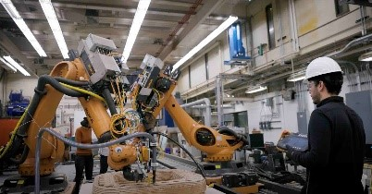
Budget Table # Description Quantity Budget required (Incl. VAT) 1 Large Autonomous Mobile Robot (AMR) for cooperative additive manufacturing (3D printing, welding, milling) 2 772,317 2 1 120,000 3 Autonomous mobile robots (AMR) with hook system for logistics 1 96,540 4 Outdoor dual-arm autonomous mobile robot 1 218,264 5 1 72,324 6 Including: 1 185,647 7 1 126,292 8 scan-line width of up to 600 mmstructured-light 1 112,100
Future Capital Call:

