Slide 1







Introduction to CeADAR

Slide 2







CeADAR -
Ireland’s Centre
for AI
Not-for-profit established in 2013
Funded by IDA Ireland and Enterprise Ireland
Based in University College Dublin
Notes:
CeADAR is Ireland’s national centre for applied AI.
It is a technology research centre founded in 2013 as a not-for-profit, we’re jointly funded by Enterprise Ireland and IDA Ireland and headquartered in the University College Dublin.

Slide 3
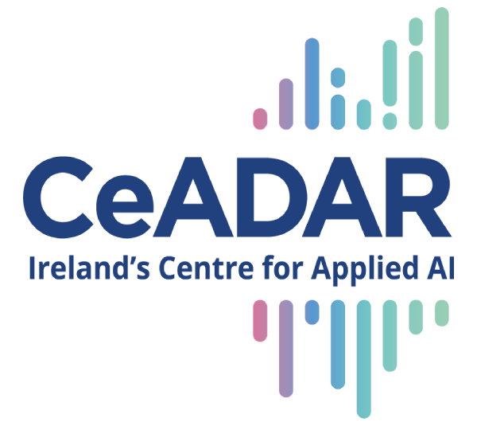
  Explore
  Experiment
  Digitalise
  Build AI solutions
Notes:
Our mission is to help organisations of every size explore, develop, and deploy trustworthy AI that drives real-world impact.
Intention was to bridge the gap between academic research in AI and industry needs.
Our mission is to support companies to explore, experiment, digitalise, and build AI solutions.

Slide 4

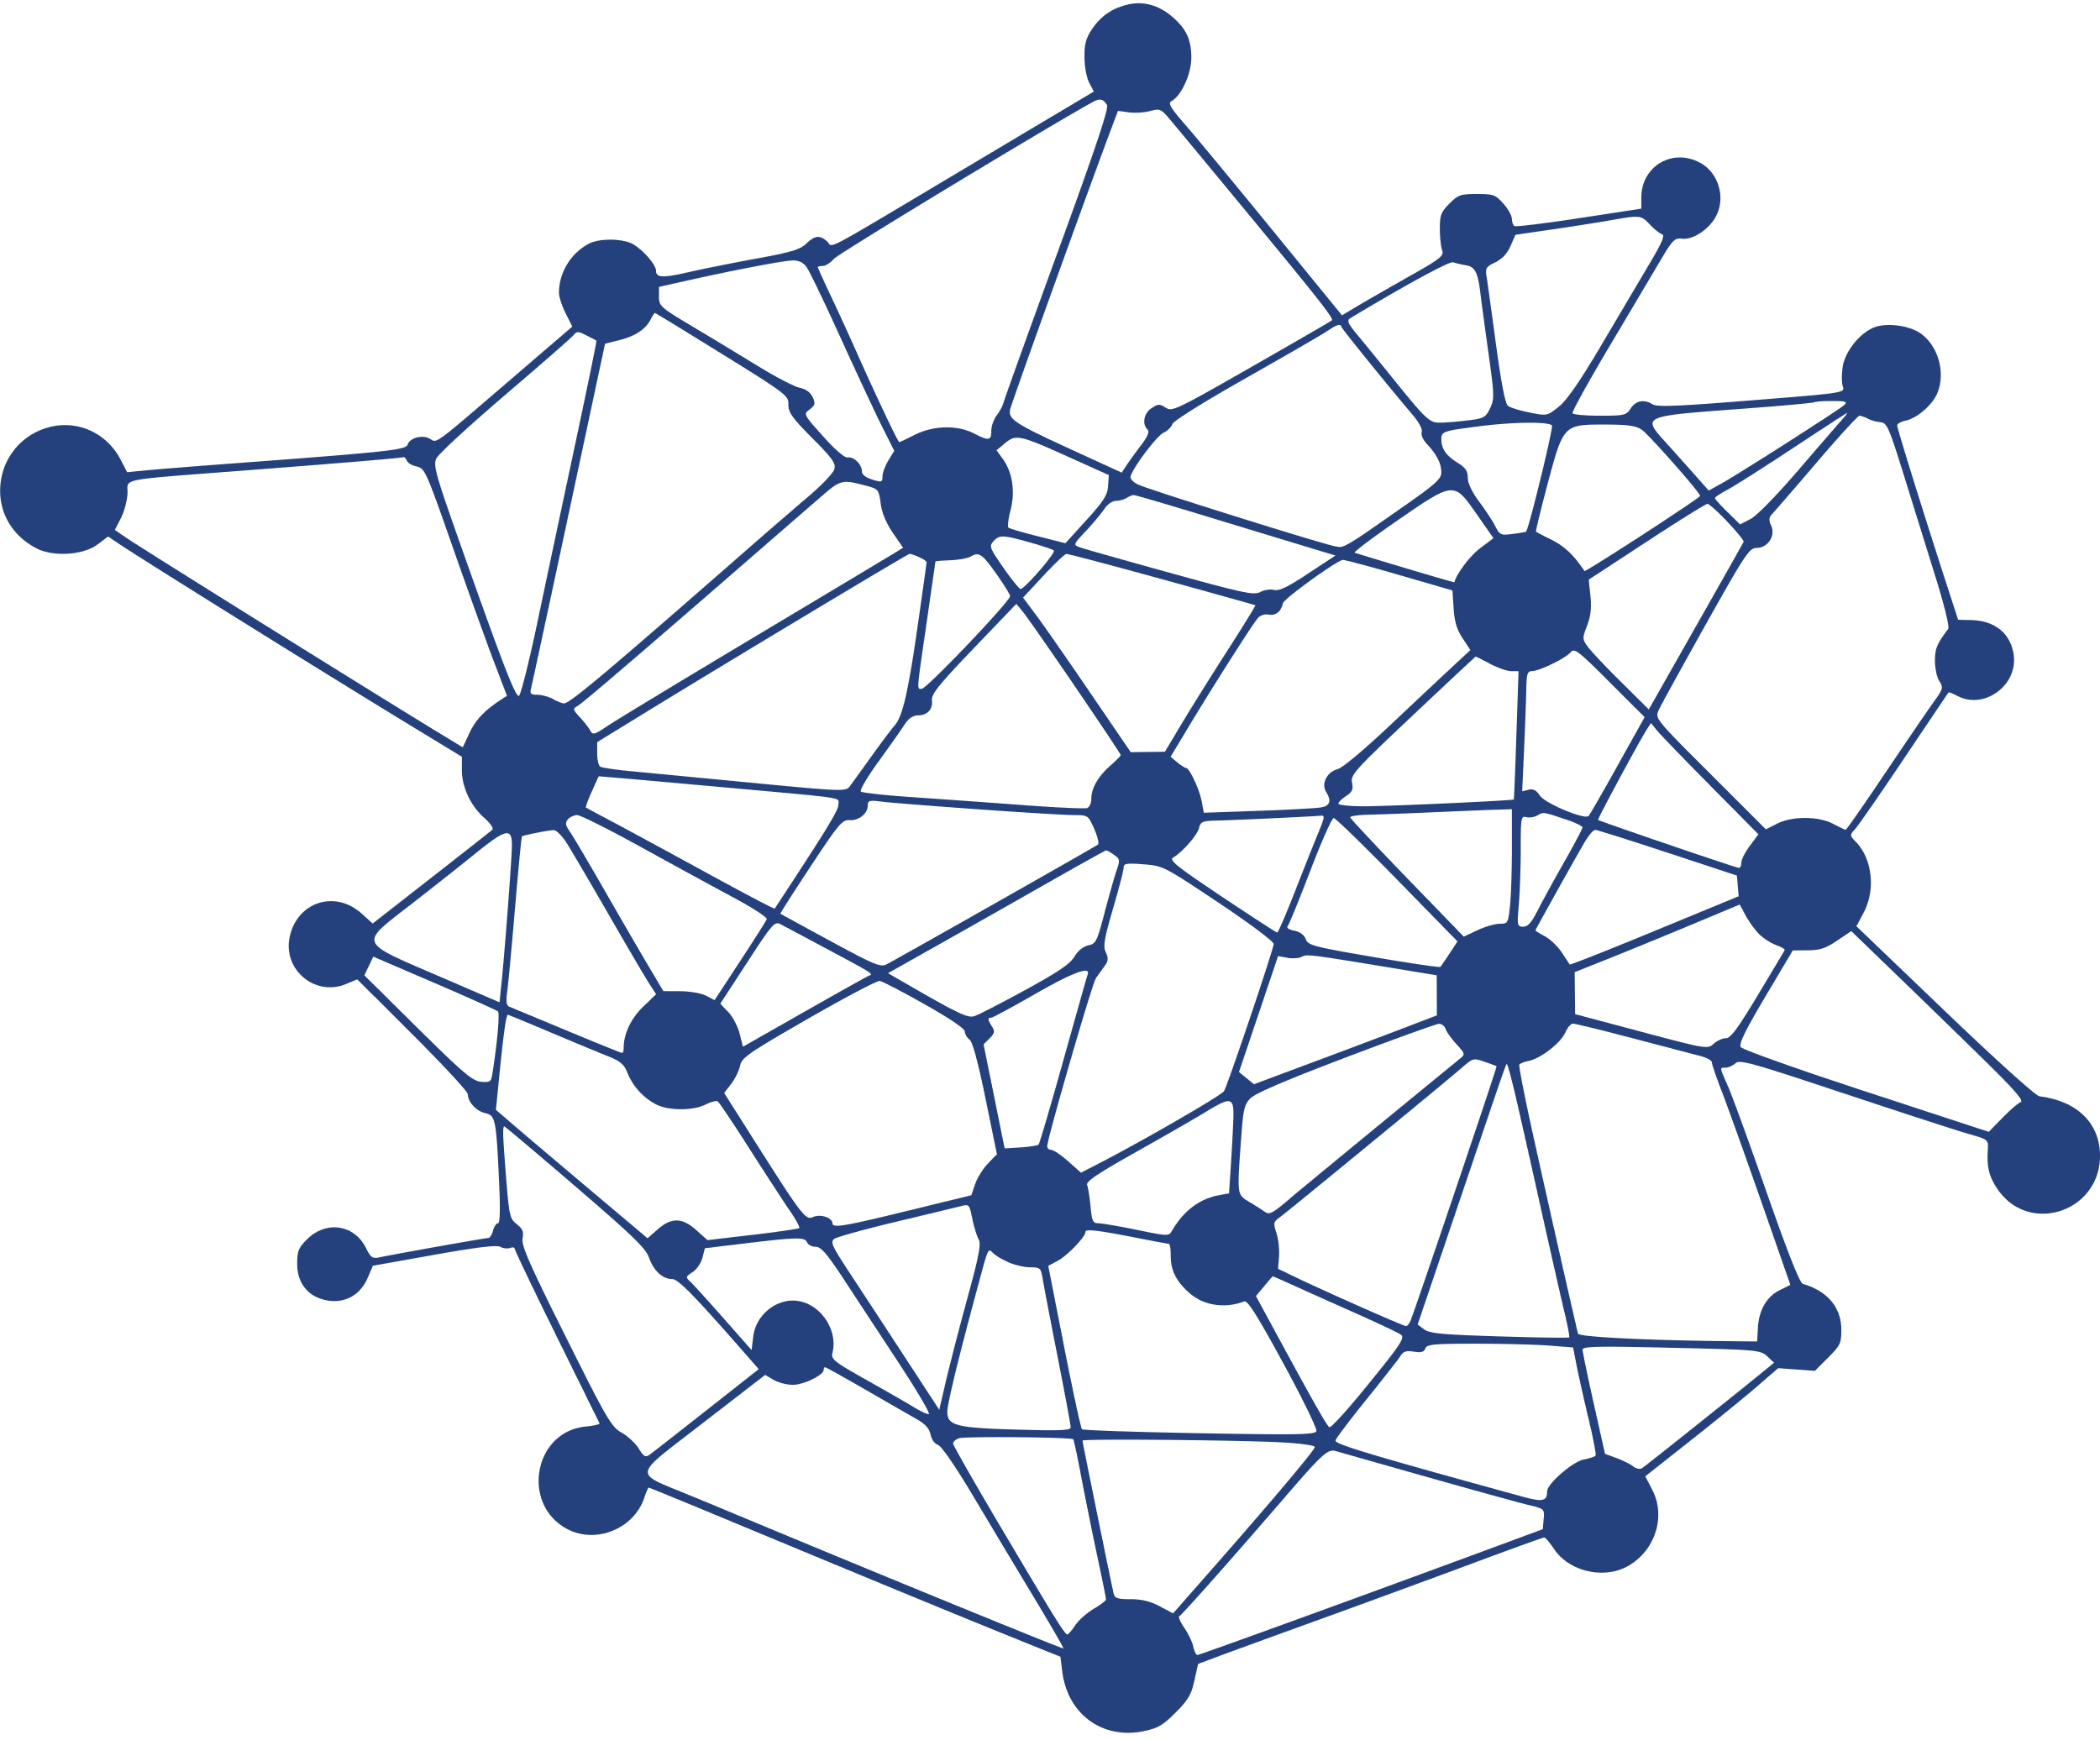









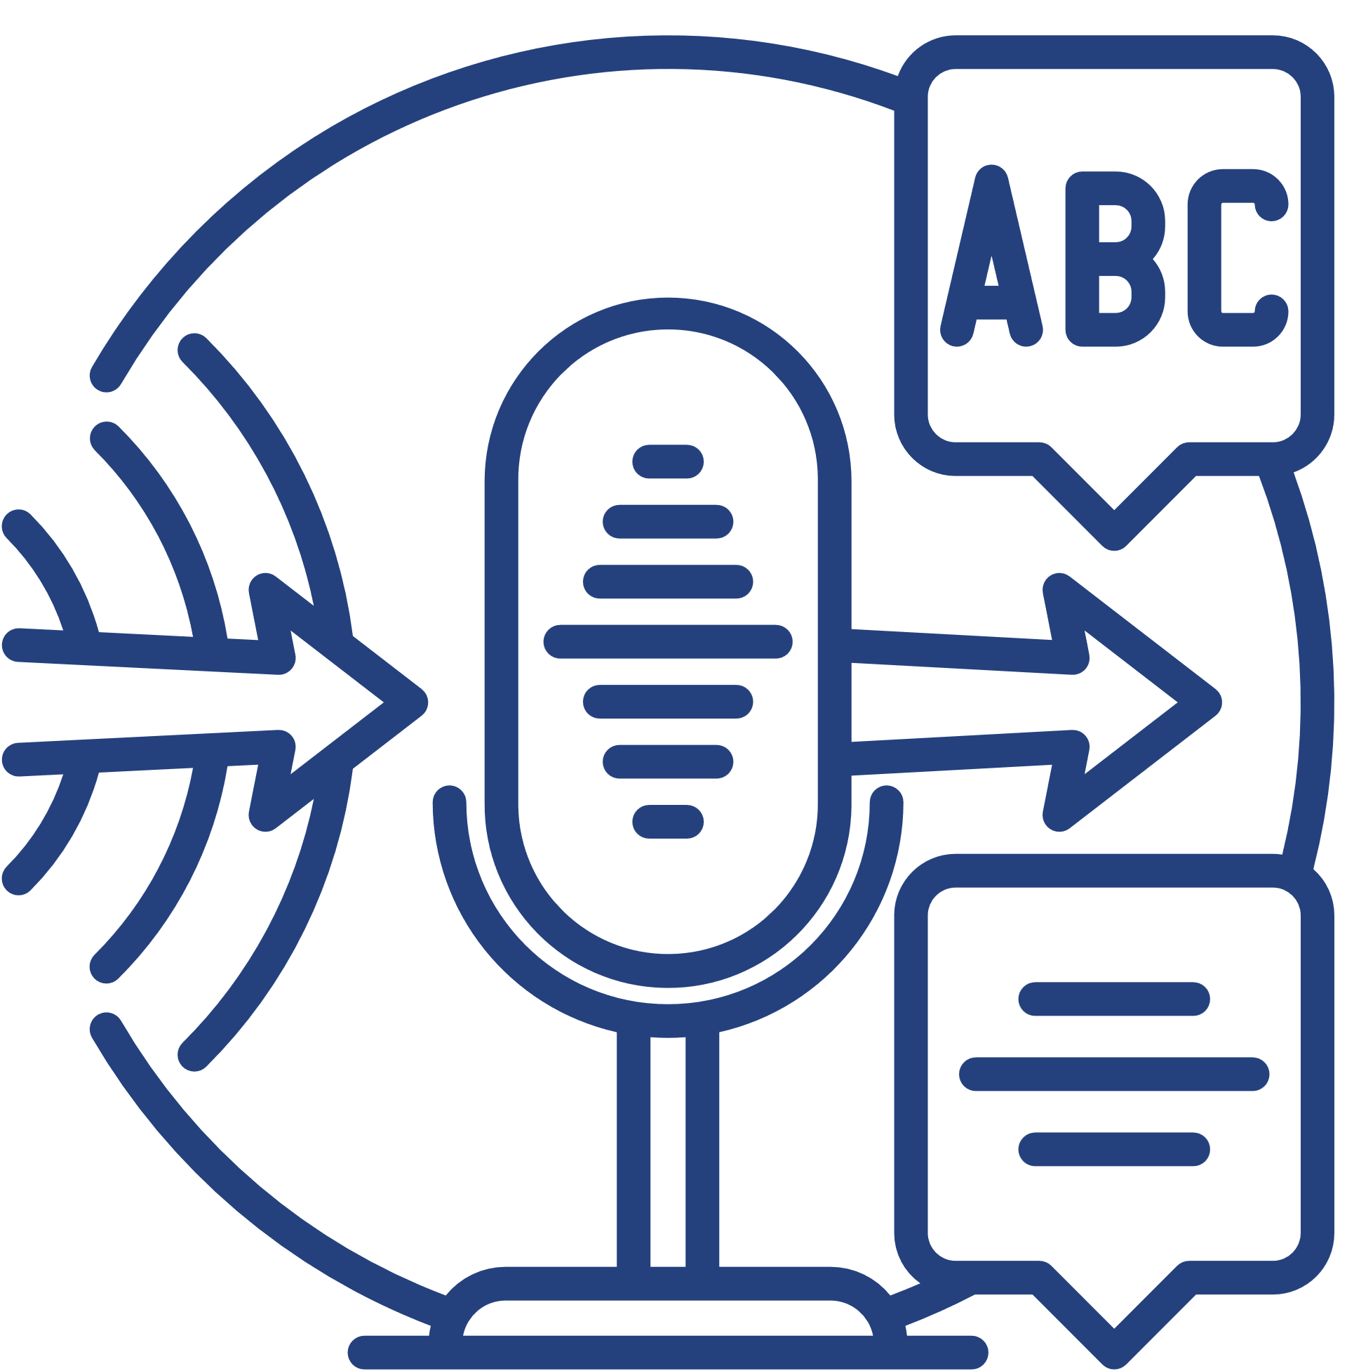












Expertise
Sectors
Machine Learning
Deep Learning
Reinforcement
Learning
Blockchain
Legal
Finance
Precision Agriculture
Green Energy
Internet of Things
Big Data
Data Viz
Audio Analytics
Media
Education
Unmanned Electrical Vehicles
Smart Cities
Data Mining
Predictive Analytics
NLP/ Text Analytics
Computer Vision/Image Analytics
Cybersecurity
Healthcare
Food Processing
Transport
Notes:
CeADAR has expertise in AI technologies.
Machine learning solutions
analysing and visualising data
explore predictive analytics
or experiment with Generative AI solutions
also we are sector agnostic
we've completed projects in legal & finance, agriculture & energy, and media & education and others

Slide 5

  Made up of 220+ hubs
  One-stop shop
  Boost competitiveness, innovation and technology
Notes:
Our experience positioned us well to apply and be selected for the EDIH Programme launched by the European Commission
The EDIH Network is made up of over 220 Hubs.
EDIHs — act as one-stop shops, empowering businesses and public sector organisations to boost competitiveness through innovation, technology.

Slide 6


  It is a 3 year programme
  Co-funded by the EU and Enterprise Ireland
  Empowering SMEs and PSOs at early stage to adopt AI
  Services are 100% discounted
Notes:
It is a three year programme, funded until August 2026 by EU and EI
We aim to empower SMEs and PSOs that are in the early stages of adopting AI
And this service is 100% discounted

Slide 7
100% Discounted Services
SME
PUBLIC SECTOR ORGANISATIONS
De Minimis Aid is a form of State support
Irish enterprises can use up to €300,000 over a rolling 3 year period, regardless of size or location.
Enterprises (under 3,000 staff) can use De Minimis ‘to pay’ for CeADAR EDIH services
If you are a Public Organisation.
Public Organisations are not subject to State Aid rules, therefore, all CeADAR EDIH services are fully funded
Notes:
Through our EDIH programme every service can be 100 % discounted.
For Irish SMEs, you can draw down De Minimis aid—up to €300k across any rolling three-year period—which covers the full cost of our support for companies with fewer than 3000 employees.
If you’re a public-sector body, State-aid rules don’t apply, so every CeADAR EDIH service is automatically and entirely funded.

Slide 8

CeADAR EDIH - AI Service Pillars
Test Before Invest
  Explore AI capabilities
  Test AI solutions
Notes:
The programme has four pillars of services.
Our test before invest pillar is designed to help you explore the capabilities of AI, and test AI solutions before investing.

Slide 9


Test Before Invest Services
Scoping Requirements
Prototype Development & Testing
  Series of Workshops
  Research solutions available on the market
  Scope requirements for Proof of Concept
Output:
  Software Requirements Specification for Prototype
  CeADAR Develops Prototype
  Client Tests Prototype
Output:
  Knowledge transfer (documentation)
  Technology transfer (prototype code)
Value: €6,800 Charge: €0
Value €25,000 Charge: €0
Notes:
Under our Test Before Invest service we remove the risk of jumping straight into a full build.
we run targeted workshops with your team, research what’s already on the market, and pin down exactly what a proof-of-concept should do.
&nbsp;&nbsp;• The output is a clear Software Requirements Specification—normally worth about **€6.8 k**, but there’s **no cost** to you.
next, CeADAR data scientists build a working prototype for you to trial in-house.
You get full documentation plus the prototype code so your team can take it forward.
That package is valued at 25 k, which is fully funded.
Together, these two steps let you validate the business case and technical fit before you invest in a full-scale solution.

Slide 10

CeADAR EDIH - AI Service Pillars
Skills Development
  Upskill and reskill
  From executives to staff
Notes:
Our second pillar is skill development
A key objective of our programme is to upskill and reskill all employees of SMEs and PSOs from executives to support staff.

Slide 11
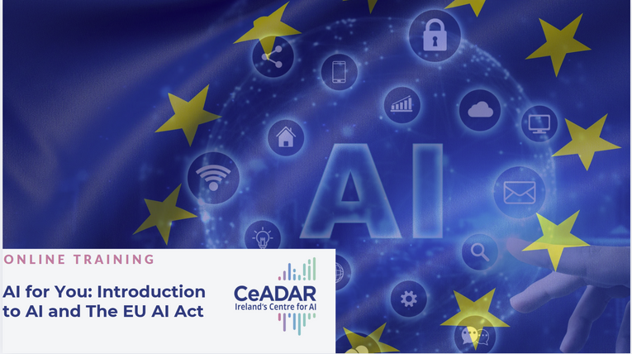

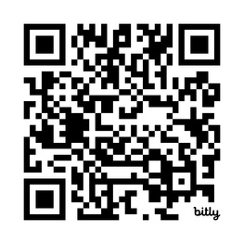
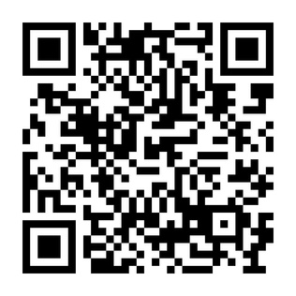
Skills Development
Open Access Charge: €0
Free, Self-paced Online Course to help you
  Understand AI and its impact
  Boost AI literacy across your organisation
  Demystify the EU AI Act
  Confidently adopt AI in your organisation
Sample Webinars
  The Art of Possible with Generative AI
  Prompt Engineering
  AI in Data Analytics
  AI-Enhanced Software Development Lifecycle
Notes:
We provide a free, self-paced online courses like ‘AI for You’
It explains what AI is, how it’s regulated under the upcoming EU AI Act, and—most importantly—how you can adopt it confidently and responsibly.
Simply scan the QR code to enrol—there’s zero charge.
And we run a rolling series of live, interactive webinars.
like The Art of the Possible with Generative AI, Prompt Engineering, AI in Data Analytics, and AI-enhanced Software Development Lifecycle.
Whether your team is brand-new to AI or looking to deepen specialist skills, these open-access resources raise literacy quickly and at no cost.

Slide 12

CeADAR EDIH - AI Service Pillars
Support to Find Investment
  Support enterprises to access additional funding
Notes:
Our third pillar is to support enterprises to access additional funding

Slide 13














Support to Find Investment
Workshop to help you
  Find a suitable funding instrument
  Support your application preparation
Value €800/person De Minimis €800/person Charge: €0
https://neh.gov.ie
Notes:
Part of our mission as an EDIH is to signpost relevant supports for start-ups and SMEs.
In case you haven't found this resource yet, the National Enterprise Hub is a great place to start when looking for supports for your business. It aggregates all of the various offerings from local enterprise office to enterprise ireland and beyond
However, we are aware that it is a lot of information and sometimes organisations prefer to be guided through what is available, or need some assistance with their application...
Therefore we can offer additional workshops to help you navigate this place. Valued at 800 per person

Slide 14

CeADAR EDIH - AI Service Pillars
Ecosystem Building
  Regular events and networking opportunities
Notes:
And finally our fourth pillar, ecosystem building
we offer regular events and networking opportunities that build a strong ecosystem for AI innovation in Ireland

Slide 15
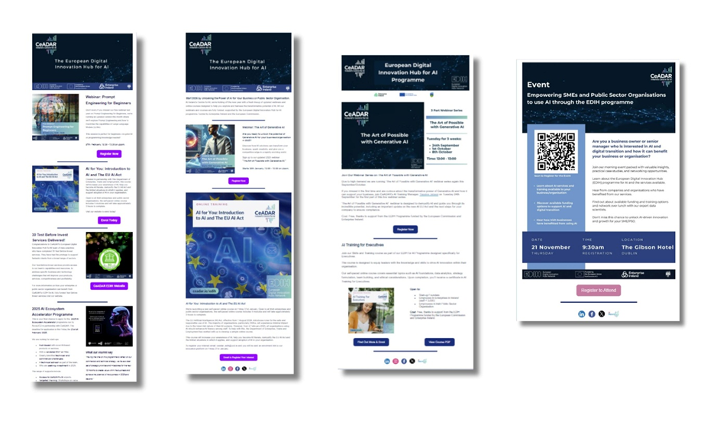
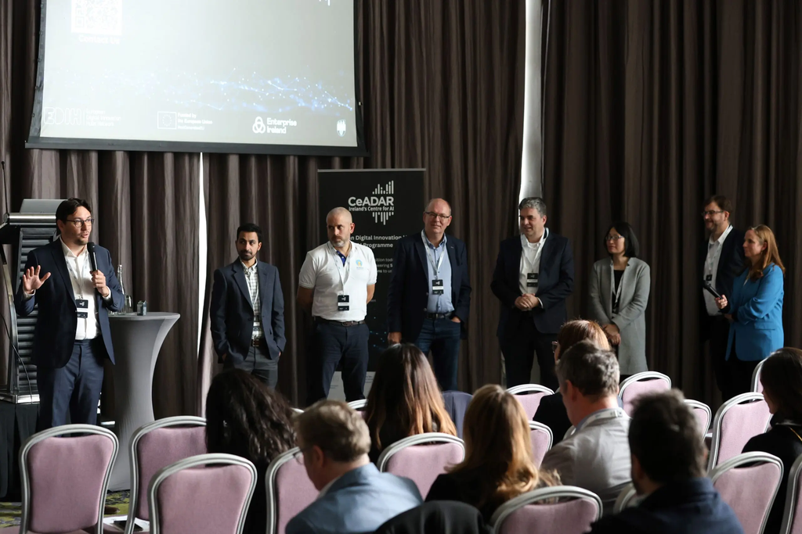
Ecosystem Building
  Events
  Newsletter
Notes:
As part of our ecosystem-building activities, we organise events that bring together stakeholders from industry, academia, and the public sector to exchange knowledge and explore collaboration opportunities.
We will also run an accelerator programme in 2026, so perhaps you can tell any friends or family with a unique product/service using AI to follow us on LinkedIn to ensure they hear when the call for applications is launched later this year.
We also produce regular newsletters to share updates on programme activities and upcoming events

Slide 16


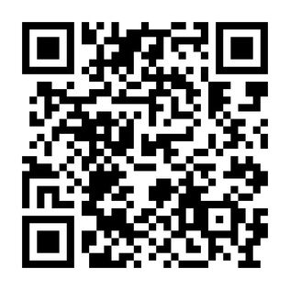
Express interest in EDIH services or sign up to our newsletter
www.ceadar.ie/edih
Notes:
If you’d like to explore any of the EDIH services you’ve seen—or simply stay up-to-date with our AI news—scan the QR code or visit ceadar.ie/edih.
We look forward to helping you turn great ideas into real-world AI impact. Thank you!

