Slide 1




Disruptive Technologies Innovation Fund – driving innovation to alter markets
January 2025

Slide 2



Call 7 is open
Open for applications until 30 April 2025
You can apply any time – **submit NOW**

Slide 3
DTIF Objectives
DE-RISK
INNOVATION
ALTER MARKETS
COMMERCIAL IMPACTS
TECHNOLOGY-BASED SOLUTIONS
RD&I COLLABORATIONS
PREPARE IRISH ENTERPRISES
FOR GROWTH/ COMPETIVENESS

Slide 4
Disruptive technology is that which has the potential to drastically alter markets and their functioning and significantly alter the way that businesses operate. While it involves a new product or process, it can also involve the emergence of a new business model.
Disruption is not about technology alone but the combination of technology and business model innovation.

Slide 5

Fundable Activity
Project must be within the scope of Industrial Research and/or Experimental Development
INDUSTRIAL RESEARCH | EXPERIMENTAL DEVELOPMENT
Industrial research, means the planned research or critical investigation aimed at the acquisition of new knowledge and skills for developing new products, processes or services or for bringing about a significant improvement in existing products, processes or services. It comprises the creation of component parts of complex systems and may include the construction of prototypes in a laboratory environment or in an environment with simulated interfaces to existing systems as well as of pilot lines, when necessary for the industrial research and notably for generic technology validation. | Experimental development, means the acquiring, combining, shaping and using existing scientific, technological, business and other relevant knowledge and skills for the purpose of producing plans and arrangements or designs for new, altered or improved products, processes or services. These may also include, for instance, other activities aiming at the conceptual definition, planning and documentation of new products, processes or services. The activities may comprise producing drafts, drawings, plans and other documentation, provided that they are not intended for commercial use.
FUNDAMENTAL RESEARCH
PRODUCT DEVELOPMENT

Slide 6
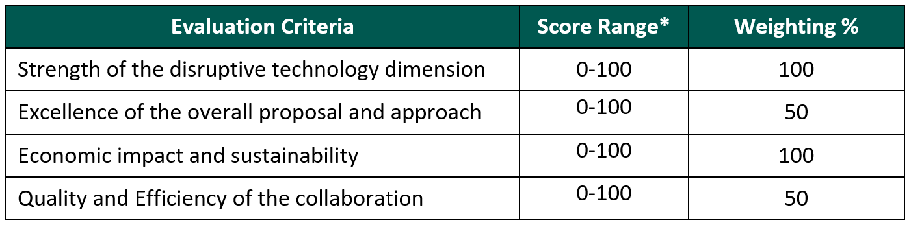
How will the proposals be scored?
Eligible written applications are reviewed by a minimum of three independent international technical/commercialisation experts. Written proposals meeting the required standard result in the DTIF consortia being invited for interview with expert panels.

Slide 7




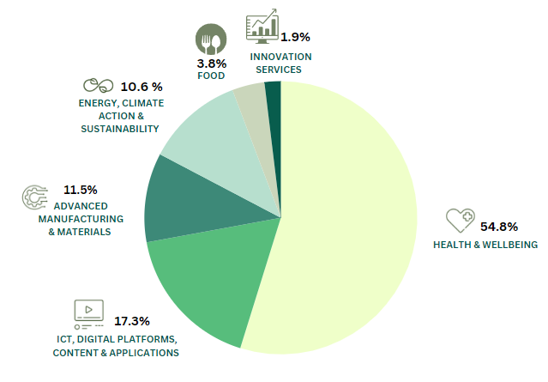






DTIF : Disruptive Technologies Innovation Fund
393
A Project Ireland 2040 National Development Plan Fund
partner investments
6
€500
million
104
calls
projects
to date
€ 371,598,117
Distribution by sector
Spend Commitment across Sectors
€ 227,736,205
€ 70,380,617
€ 31,379,706
€ 29,436,796
€ 6,546,644
€ 6,118,149
HEALTH & WELLBEING
ICT, DIGITAL PLATFORMS, CONTENT & APPLICATIONS
ADVANCED MANUFACTURING & MATERIALS
ENERGY, CLIMATE ACTION & SUSTAINABILITY
FOOD
INNOVATION SERVICES

Slide 8
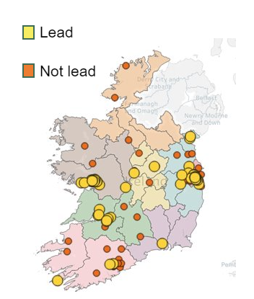
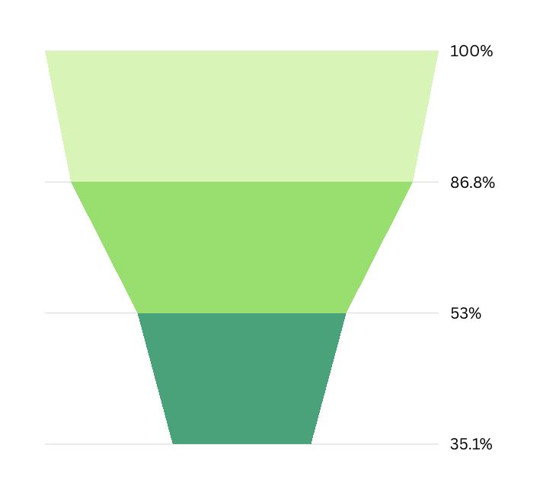
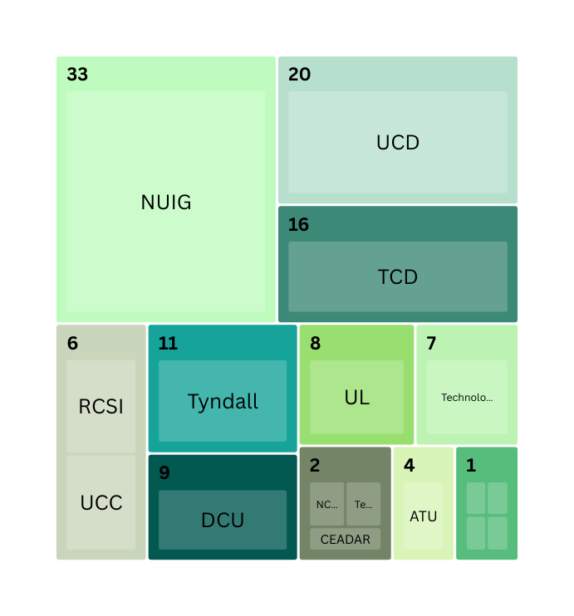

























SME led
73.1%
RPO led
19.2%
Application Rates by Stage
Projects leads & partners
MNC led
7.7%
296
Total Applications
Research Institutes by number DTIF projects
257
Consortium partner numbers per project
Eligible Applications
8
157
48
Called for Interview
32
6
104
Number of Projects
Successful Applications
4
4
1
1

Slide 9
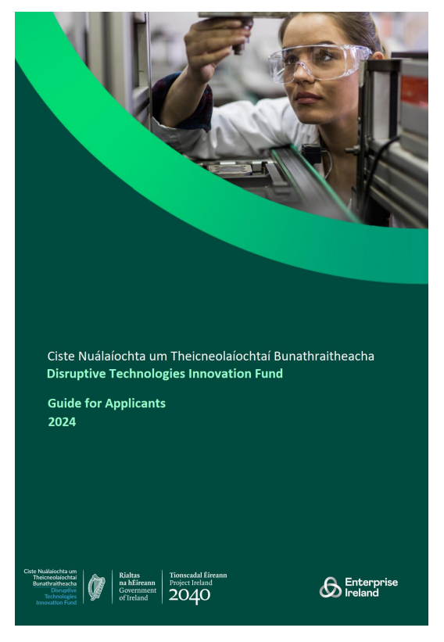
Call 7 Documents are now available on the DETE website
DETE DTIF homepage:
Disruptive Technologies Innovation Fund - DETE (enterprise.gov.ie)
Guidance documents:
Guide for applicants (PDF, 636KB)
Indicative application form (DOC, 85KB)
Consortium agreement template (DOC, 294KB)
UiD questionnaire (XLS, 122KB)
Submission link:
https://submit.link/2CW

Slide 10

Helping Irish Companies Scale Globally and attracting more inward investment
This Government will:
Launch new calls under the Disruptive Technologies Innovation Fund (DTIF) to promote collaboration between Ireland’s world-class research base and industry to pioneer new technologies and support the emergence of innovative start-ups.
Page 16

Slide 11





Meet the Team
Portfolio Managers
Jackie FitzGerald
Gerard Lande
Imelda Lambkin
Clare McKenna
Declan McGee
Email: first.last@enterprise-Ireland.com
Email: DTIF@enterprise-ireland.com
Twitter/X: @DisruptiveEI

Slide 12

Appendix

Slide 13
Thinking about applying?
  Consortium:
  The consortium must comprise at least 3 independent partners.
  The consortium must comprise at least one SME and one other enterprise partner.
  A consortium may consist of enterprises only or enterprises with one or more RPOs.
  All consortium partners collaborate to common aims and objectives.
  There should be a strategic rationale for the consortium structure.
  Funding Parameters:
  The consortium must request DTIF funding of at least €1.5 million over 3 years.
  SMEs can claim up to 50% of their eligible costs
  Large companies can claim up to 40% of their eligible costs
  RPOs can claim up to 100% of their eligible costs
  RPOs cannot receive more than 50% of the total DTIF grant aid to the project.

Slide 14
Consortium agreement
Each project partner in a collaborative partnership will be required to complete a Consortium Agreement
Template provided now to show you what you will need to consider
Note that use of this template will be mandatory, with modifications to be made for specific business reasons on an exceptional basis only

