Slide 1
Discover the support, grants, advice and training the Local Enterprise Office Westmeath can provide.
Tracey Tallon LEO Westmeath

Slide 2
Supporting Local Enterprise Development
31 Local Enterprise Offices
Retail Supports
Craft Workers
First Stop Shop
Help with range of supports
Manufacturing
Food Production
Job Creation
Tourism
ICT
Internationally Traded Services
All Size companies up to 50 employees

Slide 3
Innovation
Sustainability
Digitalisation
Competitiveness
Internationalisation
We have a range of supports geared around Strategic Focus Areas

Slide 4

01.
EXPERT ADVICE
& GUIDANCE

Slide 5
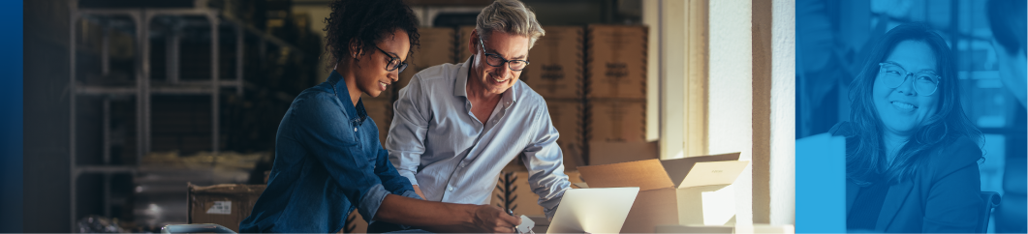
EXPERT ADVICE & GUIDANCE
MENTORING
To find out more about our Mentor Programme, contact the Local Enterprise Office Westmeath, or see
localenterprise.ie/Westmeath/Training-Events/Mentoring/
What’s it about?
Our Mentor programme has been designed to give you the benefit of an expert business practitioner’s experience.
You’ll be matched with a mentor who can provide both practical and strategic advice to help with decision making.
At a glance
For new or established business owners
Max 9 hours with an experienced mentor
All costs covered
Who’s it for?
The Mentor Programme is open to both new and existing businesses.
How does it work?
Together with your Mentor you’ll target the key areas that will most benefit your business, these could include business strategy, financial planning, market research or even more operational and production planning.
Your Mentor will provide advice and direction, discuss innovative ways of addressing the businesses challenges, help you develop a business plan and share their experience and knowledge.

Slide 6
EXPERT ADVICE & GUIDANCE
TRAINING PROGRAMMES
Types of Programmes
Digital Media Bootcamps
AI Programmes
Workshops – Financials, Pricing & Costing
Legislative
Export Development Programmes
Management Development Programme - the aim of this programme is to provide you with the management, leadership and business skills to help you grow your business.
Sectoral - Food Academy Programmes
To find out more about our Training Programmes, contact the Local Enterprise Office Westmeath, or see localenterprise.ie/westmeath/training
What’s it about?
Our training supports are tailored to meet specific business requirements - and we will be able to inform you of specific upcoming training opportunities.

Slide 7
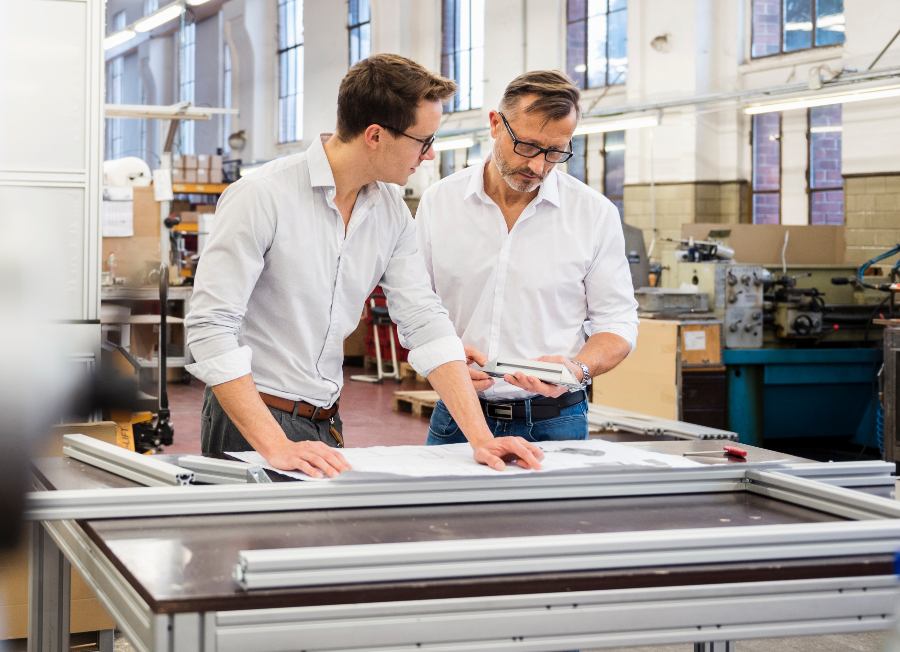
02.
PRODUCTIVITY & COMPETITIVENESS SUPPORTS

Slide 8

PRODUCTIVITY & COMPETITIVENESS SUPPORTS
LEAN FOR BUSINESS
To read some previous case
studies and find out more
about Lean for Micro see
localenterprise.ie/Westmeath/lean
What’s it about?
LEAN practices help businesses understand where they can identify and reduce waste within their processes. This could be waste when it comes to time, resources or money.
The LEANer your business is, the more efficient it is - it’s about working smarter, not just harder.
Who’s it for?
Small businesses that understand that their processes are not as efficient as they could be. It’s about building the capabilities of a businesses workforce to identify and make changes themselves.
How does it work?
Our expert LEAN consultants will visit your business, evaluate your processes and speak with your managers. Following this initial appraisal, training and mentoring across 5 days will take place and LEAN tools and techniques will be applied to a specific project.
A final report, case study and metrics will then be developed to show the positive impact on your business.

Slide 9
PRODUCTIVITY & COMPETITIVENESS SUPPORTS
GREEN FOR BUSINESS Small Changes. Big Impact!
Who’s it for?
Small and Medium businesses that are looking towards developing greener business practices. You may already have instigated some sustainable policies, or you may be
starting from scratch, either way Green for Micro can help.
Open to all businesses trading over 6 months up to 50 employees.
How does it work?
You will be paired with a Green Consultant who will provide you with two days of mentoring and technical advice - followed up with a unique report for your business that will help you decide the next steps in your sustainability journey.
What’s it about?
Every business is now working toward a greener future by incorporating sustainable practices into their day-to-day operations. We’re here to help businesses to improve their environmental performance through greater resource efficiency, driving competitive advantage and reducing costs.
Green for Business is a free programme that helps you take the first steps towards becoming more sustainable.
To find out what’s involved in
Green for Micro watch our
webinar and get more details at
localenterprise.ie/Westmeath/green

Slide 10
PRODUCTIVITY & COMPETITIVENESS SUPPORTS
Energy Efficiency Grant
To find out what’s involved in
Green for Micro watch our
webinar and get more details at
localenterprise.ie/Westmeath/green
How does it work?
The Energy Efficiency Grant supports the investment in technologies and equipment identified in a Green for Business Report, GreenStart Report or a SEAI Energy Audit with 75% of eligible costs up to a maximum grant of €10,000.
Eligible Costs
Meters (electricity, gas, diesel, oil, water, steam & loggers) and installation costs
Smart energy controls e.g., heating, cooling, lighting, automatic on/off systems, parasitic load controls
Upgrade lighting to LED (only as part of a package of eligible cost measures)
Replacement/upgrade with more energy efficient system, e.g. Heat Pumps (including air, water, and ground source) for manufacturing heating processes
Heat recovery
Small wind & hydro subject to feasibility assessment
Equipment (>5 years) replacement/upgrade such as refrigeration unit, electric steam boiler, electric oven, industrial dishwasher, engineering equipment
System components upgrades such as variable speed drives, pumps, fans, condensers, extraction systems, cold room doors
What’s it about?
The aim of the scheme is to reduce the impact of enterprises on the environment thereby increasing the agility and resilience of these businesses
Who’s it for?
Small businesses that are looking towards developing greener business practices. You may already have instigated some sustainable policies, or you may be
starting from scratch.
Open to all businesses trading over 6 months up to 50 employees.
Needs be in rateable premises.

Slide 11
Digital for Business (Up to 3 days consultancy)
Engagement of a digital expert to support a business-driven digital initiative with practical hands-on guidance that could include:
  Analysis of existing digital systems in the business to identify potential gaps in meeting business needs.
  Exploration of opportunities to optimise existing systems and to integrate with new solutions to enhance business operations.
  Guidance on the implementation of new or enhanced digital solutions.
Expected Outcomes
Creation of a digital action plan, with targeted initiatives for the next 3 - 6 months.
The consultant submits an action plan to the Local Enterprise Office and the client.
What is not covered
Routine or business as usual upgrades of Digital systems already in use that would not lead to a significant improvement in the business.

Slide 12
Grow Digital Voucher
What is it?
Voucher of €5,000/50% cost towards digital transformation Software
Training & Configuration covered
< 50% of the overall project cost
Boost Efficiencies
Enhance productivity
Expand Customer Reach
Stay Competitive – Bridge the Digital Gap
Who is it for?
Any Business up to 50 employees
Those who have completed a Digital for Business Project within the previous two years
How to Apply?
Business must be trading more than 6 months
Not a client of EI or IDA
Talk to your LEO representative before commencing any work.
Complete your Digital for Business action plan with an assigned LEO consultant

Slide 13

Eligible Software Examples
E-commerce Software
Online payments
Job Tracking
Stock Control
Order Management
Cybersecurity Software
CRM systems
Analytics Software
AI
3 D Modelling
Self Assessment Tool &
Case Studies online

Slide 14

03.
FINANCIAL SUPPORTS

Slide 15

FINANCIAL SUPPORTS
FEASIBILITY STUDY GRANTS
To find out more about Feasibility Study Grants, contact the Local Enterprise Office Westmeath, or see
localenterprise.ie/westmeath
What’s it about?
Understanding the potential market and likely success of your new business, product, or service is a vital step in
the development of a business. Feasibility Study Grants are intended to help you with the costs and take you from market research to technical development.
Who’s it for?
Small businesses with 10 or less employees engaged in manufacturing or internationally traded services who can demonstrate a market for their product
or service and have the potential to grow and create jobs in the domestic
or international market.
How does it work?
The Feasibility Study Grant includes help with design and prototype development, consultancy requirements, and market research. The grant amounts to 60% of the investment up to a maximum of €15,000.

Slide 16

FINANCIAL SUPPORTS
What’s it about?
Getting your new business up and running can require substantial investment from you or your backers. The Priming Grant is intended to help you offset some of those costs - from salary to capital expenditure.
Who’s it for?
Small businesses with 10* employees
or fewer within the first 18 months of
start-up in the manufacturing or internationally traded services sectors, creative, ICT, Innovative Projects.
How does it work?
Priming Grants are intended to support salaries, capital expenditure, consultancy, and marketing costs. Capital items can include
office equipment, fit out of the workplace, and fixed technology costs.
What we look for?
Economically Viable
Availability of Matching Finance
No potential for deadweight or displacement
Quality of Project
Job Creation
PRIMING GRANTS
To find out more about Priming Grants, contact the Local Enterprise Office Westmeath, or see localenterprise.ie/westmeath
*Businesses with 10 employees must complete an Internationalisation Plan

Slide 17

FINANCIAL SUPPORTS
BUSINESS EXPANSION GRANTS
To find out more about Business
Expansion Grants, contact the Local Enterprise Office Westmeath, or see localenterprise.ie/westmeath
How does it work?
Business Expansion grants cover up to 50% of the investment or
up to €150,000 - whichever is
the lesser.
What does it cover?
Capital items
salary costs
Consultancy and marketing
General overheads.
What’s it about?
Moving from start-up into a growth phase can be an exciting time and
bring many new opportunities.
Business Expansion Grants help
you to safely steer your business through this new phase.
Who’s it for?
Small businesses with 10* employees or fewer trading for more than 18 months in the manufacturing or internationally traded services sector.
*Businesses with 10 employees must complete an Internationalisation Plan

Slide 18
FINANCIAL SUPPORTS
R&D Innovation FUND
What’s it about?
Innovation is the beating heart of any business - to continue to be competitive you need to be looking for new or improved products, services or processes.
Who’s it for?
Any business in the manufacturing or internationally traded
services sectors trading at least 18 months preferably.
The development of the new products or services that must involve:
the resolution of some technical challenges,
be non-routine
represent a ‘step-up’ for the company in terms of the level of RD&I capability.
How does it work?
The R & D Fund provides funding of up to €150,000 for you to undertake the approved innovation.
Eligible Costs
Salaries
Technical Consultancy
Contractual Research
Clinical Trials
Patent Advisory Costs
Equipment Costs
Overheads
Materials

Slide 19
FINANCIAL SUPPORTS
TECHNICAL ASSISTANCE
FOR MICRO-EXPORTERS
To find out more about TAME,
contact the Local Enterprise Office Westmeath, or see localenterprise.ie/westmeath
Who’s it for?
Small businesses with 10 employees
or fewer engaged in manufacturing or internationally traded services who can demonstrate a market for their product
or service and have the potential to
grow and create jobs in the domestic
or international market.
How does it work?
TAME is intended to help you branch
out into new markets with a grant of
50% (up to €2500) of associated costs
in a calendar year. The grant covers participation at trade fairs, the development of marketing materials
for new markets and other activities associated with the push into
new markets.
What’s it about?
Taking the step from the Irish market to looking towards international markets requires a lot of research and leg work.
You may need to attend or exhibit at trade fairs or rework your promotional material for your new markets.
TAME aims to help you offset some
of those costs.

Slide 20
FINANCIAL SUPPORTS
GRADSTART
What’s it about?
Gradstart is about attracting top graduate talent to your business to improve the skills base within their business
Grants of €15,000 per year, or 50% of individual graduate salary costs (whichever is the lesser) on a 2-year contract. €30,000 in support.
€21,000 per year is also available for language support roles. The graduate role must have a clear requirement for language proficiency
Who’s it for?
Any business in the manufacturing or internationally traded
services sectors with 5 or more existing employees
How does it work?
Define a project aligned to growth plan for each graduate to complete. e.g. new products and services, enhance processes. Roles in any discipline are eligible for support, except for direct sales and direct marketing positions.
Apply - www.gradhub.ie
.
To find out more about the
Gradstart, contact the Local Enterprise Office Westmeath, or see localenterprise.ie/westmeath

Slide 21
FINANCIAL SUPPORTS
MICROFINANCE IRELAND BUSINESS LOANS
What’s it about?
Microfinance Ireland (MFI) offer Business Loans from €2,000 to €25,000
Loan terms from 1 - 5 years
No fees or charges
Fixed repayments with no penalty for early repayment
Who’s it for?
Micro-enterprises with 10 or less employees
How does it work?
If you apply for an MFI business loan through you local LEO, you avail of a 1% reduction in the interest rate, as well as financial mentoring to help complete your application.
.
To find out more, contact the Local Enterprise Office Westmeath, or see localenterprise.ie/westmeath

Slide 22

PAGE HEADER
SHOPFRONT ENHANCEMENT GRANT
To find out more about the
Shopfront Enhancement Grant, contact the Local Enterprise Office Westmeath, or see localenterprise.ie/westmeath
What’s it about?
Grants of up to €4500 or 75% eligible costs for solo projects
Grants of up to €6000 for collaboration or Disability/Age Friendly Projects.
Who’s it for?
Rates paying businesses in Westmeath.
Previous grant recipients may now apply for a second voucher.
Eligible Works
Repair & reinstatement to shop front
Architectural/historic features
Repainting
Signage
Shutters
Power washing

Slide 23
Questions ?

Slide 24
THANK YOU
www.localenterprise.ie/westmeath
Tel - 04493 38945
Follow us on Facebook, Instagram, Twitter and LinkedIn

