Slide 1
Longford Westmeath ETB

Slide 2
eCollege
eCollege is the digital gateway to further education and training and funded by SOLAS. Our mission is to provide an excellent learning experience, tailored to enhance your skills and empower your personal and career growth.
We work closely with learning providers to give you free, part-time courses highly valued by employers and that are enjoyable and engaging.
We offer a range of courses to suit learner needs, which could be formal accreditation supported by online tutors, or self directed courses to help you build your knowledge.
What is included?
If your course requires software, this is included and available for the duration of your course
If your course is accredited, the cost of the online exam and certification is included in your course
If your course has tutor support, live tutorials will always be available as a recorded version so you can study and progress at a time that suits you.
Notes:
Adrian

Slide 3
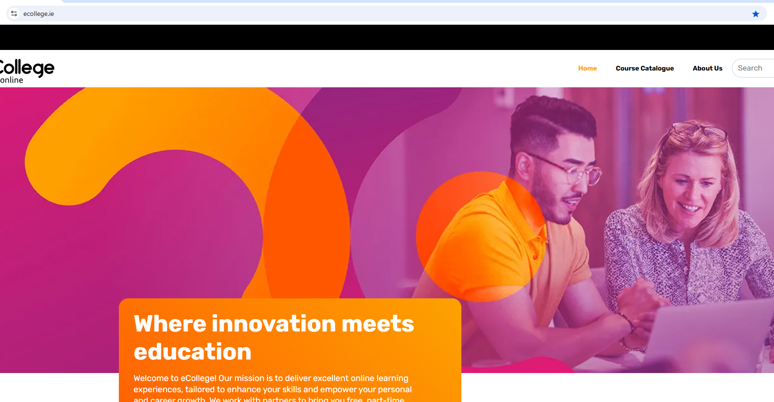
Notes:
Adrian

Slide 4
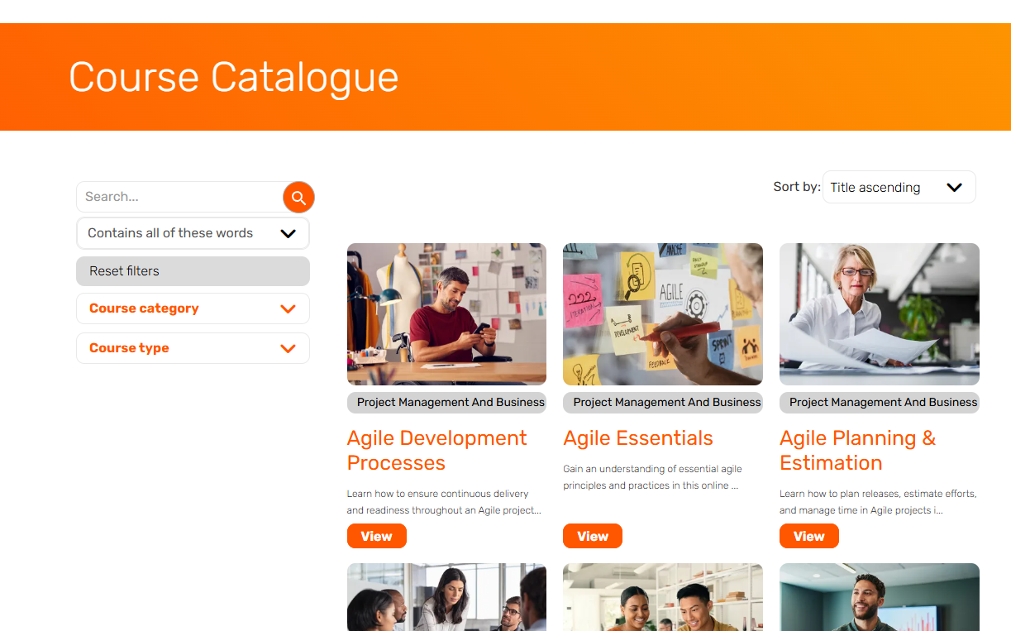

Slide 5
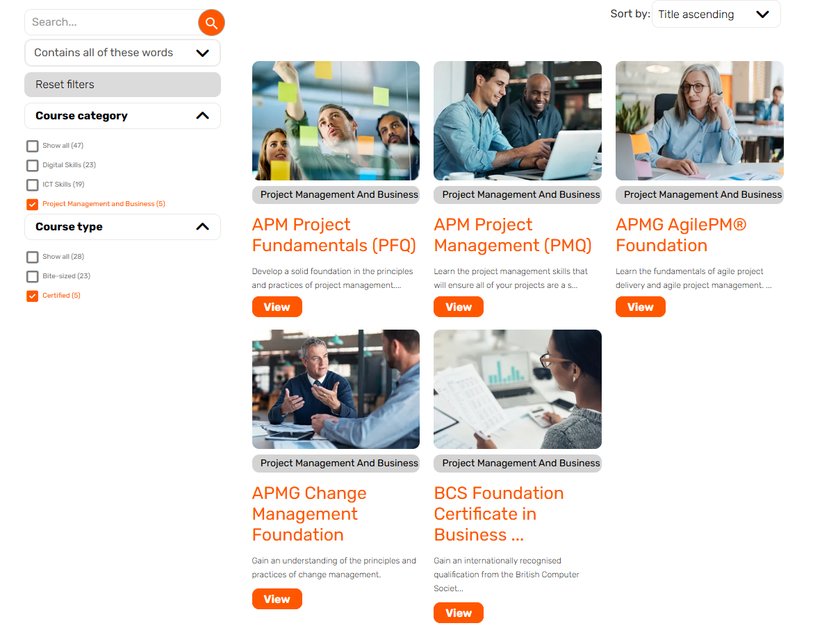

Slide 6
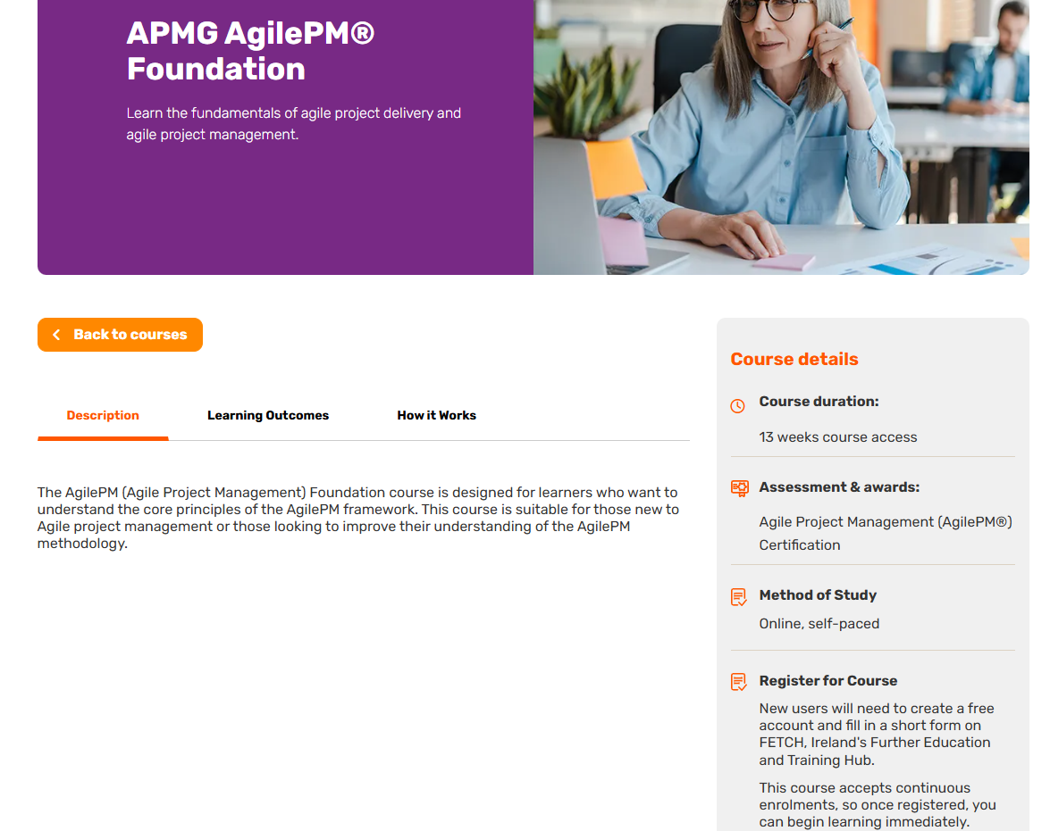

Slide 7
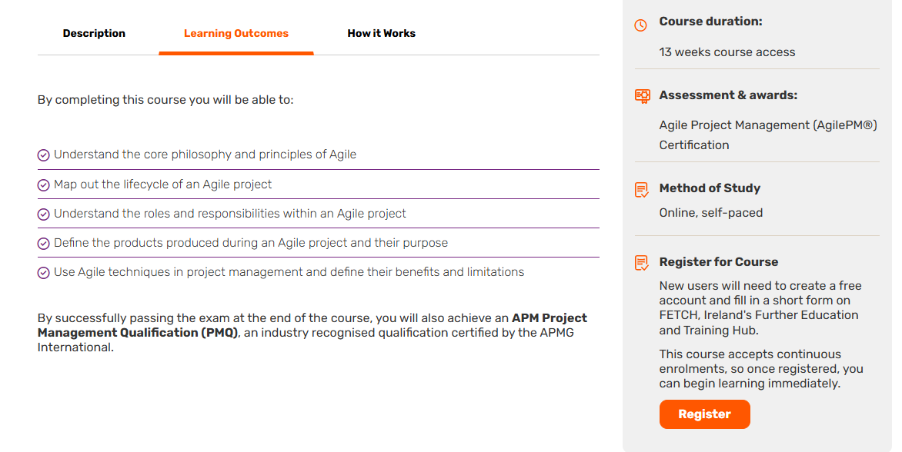

Slide 8
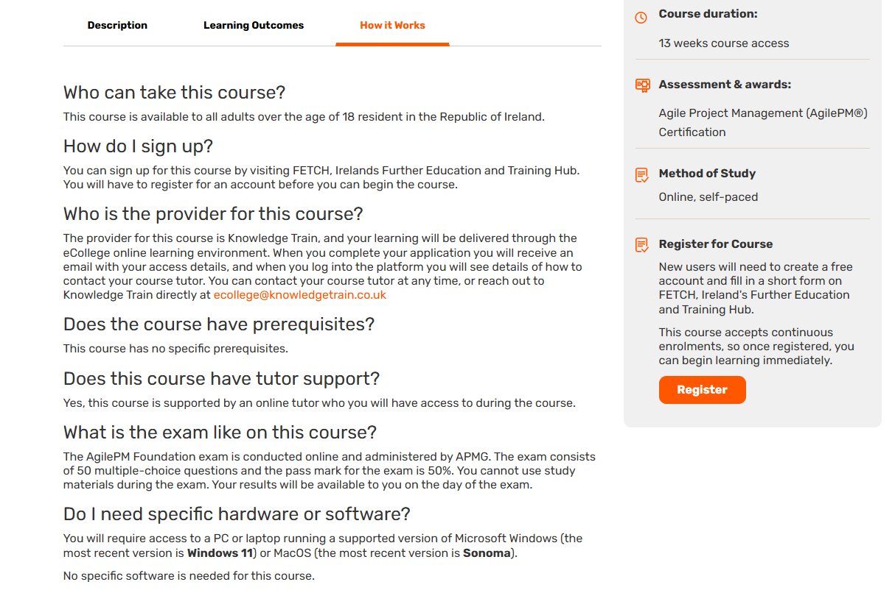

Slide 9
ICT Skills Pathways 2025
Skills Focus | ICDL Coding Principles | CompTIA ITF+ | CompTIA A + | Pearson ITS Networking | Pearson ITS Network Sec | CompTIA Network + | CompTIA Security + | CompTIA Data + | CompTIA CYSA+ | CompTIA Linux+ | CompTIA Server + | Microsoft Azure Cloud | CompTIA Cloud Essentials | AWS Cloud Practitioner | CompTIA PenTest+ | Pearson ITS Java | Pearson ITS Java Script | Pearson ITS HTML & CSS | Cisco Network Associate | Cisco Cybersecurity | Introduction to PowerBI | Pearson ITS Databases | Certified Associate Python | Azure Cloud Fundamentals
IT Support |  | ● | ● |  |  | ● | ● |  |  | ● | ● | ● |  | ● |  |  |  |  |  |  | ● | ● | ● | ●
Network |  |  | ● | ● | ● | ● | ● |  | ● | ● | ● | ● | ● |  |  |  |  |  | ●
Cybersecurity |  |  |  |  | ● | ● | ● |  | ● |  |  |  |  | ● | ● |  |  |  |  | ● |  | ● |  | ●
Software & Web Development | ● |  |  |  |  |  |  |  | ● |  |  |  |  |  |  | ● | ● | ● |  |  |  |  | ●
Data |  | ● |  |  |  |  |  | ● |  |  |  |  |  |  |  |  |  |  |  |  | ● | ●
Experience Level
No Experience | ● | Beginner | ●
Intermediate | ● | Advanced | ●

Slide 10
Digital Skills Pathways 2025
Skills Focus | Online Learning Skills | ICDL Essentials | MOS Word | MOS Word Expert | MOS PowerPoint | MOS Excel | MOS Excel Expert | MOS Access | ICDL Cybersecurity | ICDL Online Collaboration | ICDL Data Protection | ICDL Remote Work | ICDL Teamwork | ICDL Artificial Intelligence | ICDL Big Data | ICDL Cloud Computing | ICDL Internet of Things | ICDL Databases | ACA Visual Design using Photoshop | ACA Graphic Design Illustrator | ACA Print & Digital Media InDesign | ACA Digital Video Premier Pro | ICDL Coding Principles | ICDL Data Analytics | ICDL Digital Design & Marketing | Certified Digital Marketing Prof
Essential Digital | ● | ●
Modern Workplace | ● |  |  |  |  |  |  |  | ● | ● | ● | ● | ● | ● | ● | ● | ● | ● |  |  |  |  |  | ● | ●
Applications | ● | ● | ● | ● | ● | ● | ● | ● |  |  |  |  |  |  |  |  |  |  | ● | ● | ● | ●
Analytical | ● |  |  |  |  |  |  |  |  |  |  |  |  |  |  |  |  |  |  |  |  |  | ● | ●
Digital Marketing | ● |  |  |  |  |  |  |  |  |  |  |  |  |  |  |  |  |  |  |  |  |  |  |  | ● | ●
Lorum Ipsum
Experience Level
No Experience | ● | Beginner | ●
Intermediate | ● | Advanced | ●

Slide 11
Project Management Pathways 2025
Skills Focus | Fundamentals of PM | Fundamentals Change Mgmt. | Agile Essentials | Project Management Intermediate | Agile Essentials | Agile Planning and Estimation | Agile Team Dynamics and Leadership | Agile Development Process | Agile Ways of Working – Continuous Improvement | Agile Ways of Working – Tracking and Visualisation | APMG Change Management Foundation | APMG Change Management Practitioner | APMG Building Better Business Cases Foundation | APMG Building Better Business Cases Practitioner | APM Project Fundamentals (PFQ) | APMG Agile PM Foundation | APM Project Management (PMQ) | Scrum Agile Essentials | APMG Agile PM Practitioner
Project & Change Management | ● | ● | ● | ● |  |  |  |  |  |  | ● | ● | ● | ● | ● | ● | ● |  | ●
Agile |  |  |  |  | ● | ● | ● | ● | ● | ● |  |  |  |  |  |  |  | ●
Experience Level
No Experience | ● | Beginner | ●
Intermediate | ● | Advanced | ●

Slide 12
Business & Transversal Skills Pathways 2025
Skills Focus | Fundamentals of Leadership | Intermediate Leadership | Advanced Leadership | Professional Skills | Communication Skills | Business Analysis Essentials | Fundamentals of Team Mgmt. | BCS Business Analysis Practice | BCS Modelling Business Processes | BCS Foundation Cert Business Analysis | BCS Requirements Engineering | BCS Essentials in Artificial Intelligence | BCS Foundation Certificate in Artificial Intelligence | Business Strategic Analysis | Business Performance Management | Problem solving and decision-making techniques | Business Analysis – Requirements gathering and validation | Business Planning and Execution | CMI/ ILM Level 5 Certificate in Leadership and Management | Customer Service Fundamentals | Customer Service Intermediate | Customer Service Success Advanced | Personal Development at Work | Advanced Sales Tactics | Introduction to Diversity and Inclusion | Bias, Conversations and Allyship: Advancing inclusion at work.
Business Analysis |  |  |  |  |  | ● |  | ● | ● | ● | ● | ● | ● | ● | ● | ● | ● | ●
Transversal | ● | ● | ● | ● | ● |  |  |  |  |  |  |  |  |  |  |  |  |  |  | ● | ● | ● | ● | ● | ● | ●
Leadership and Management |  |  |  |  |  |  | ● |  |  |  |  |  |  |  |  |  |  |  | ●
Experience Level
No Experience | ● | Beginner | ●
Intermediate | ● | Advanced | ●

Slide 13
Sustainability Foundations 2025
Skills Focus | Energy & You: Reduce Your Use | Sustainability in the Workplace | Biodiversity | Energy Management | Water Conservation
Sustainability | ● | ● | ● | ● | ●

Slide 14
Thank you! For any queries please contact: Enterprise@LWETB.ie

