Slide 1
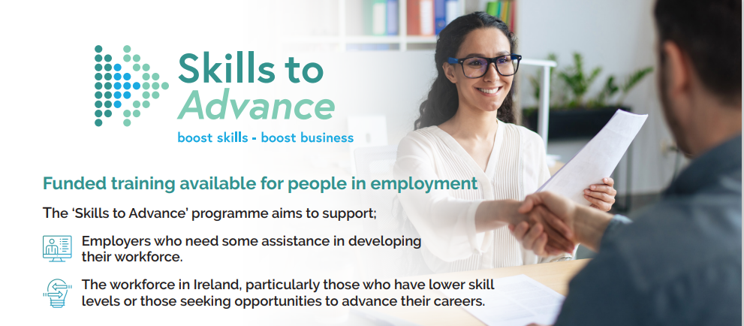

Slide 2
Addressing Skills Gaps in Tech
A Collaborative Approach to Skills Development
Longford Westmeath Service to Business
supports workforce development.
We provide tailored, fully funded training solutions.
.
Our programs boost skills, drive growth, and ensure a future-ready workforce.

Slide 3
Key Programmes for Tech Business
Skills to Advance
eCollege
Tech Apprenticeship
Access self-paced certified online courses for continuous learning.
Upskilling tailored to meet the specific needs of your business.
Build future tech talent through structured, hands-on learning.

Slide 4
Skills to Advance
1
Fully Funded Training
No cost for eligible employees or organisations.
2
Training Needs Analysis
Identify workforce gaps.
3
Customised Training Plans
Tailored content and flexible delivery methods.
4
Flexible Scheduling
Online, in-person, onsite, and offsite options available.

Slide 5
Recent training local Tech Businesses accessed
Institute of
Leadership & Management (ILM)
Institute of Leadership & Management (ILM)
Institute of Leadership & Management (ILM)
Institute of
Leadership &
Management (ILM)
Conflict Management
Understanding the Management Role for Improved Performance
Developing your
leadership Style.
Managing Time & Meetings
Leadership &
Management
EXCEL
Basic
Intermediate
Advanced
Change Management

Slide 6
Easy Steps to Get Started
Contact Us
Needs Analysis
Programme Design
Implementation
Reach out to our Enterprise Support Team.
Identify specific training requirements.
Create a bespoke training plan.
Flexible and business-friendly training delivery.

