Slide 1
FactoryXChange: Connecting Businesses to Digital Solutions
Helping Midlands businesses access digital services, funding, and support
Notes:
Good morning everyone, and thank you for being here today. My name is Laura Molloy, and I’m excited to introduce you to FactoryXChange – a platform designed to help businesses like yours access digital services, funding, and support."
"At FactoryXChange, we’re not just about technology. We’re about helping businesses use technology in practical, effective ways that create real-world impact. Whether it’s securing funding for innovation, upskilling employees, or testing new technologies, our goal is to make digital transformation accessible and actionable.

Slide 2
Who we are
We are not just tech advocates, we are tech translators, enabling digital transformation across Ireland
We work hard to connect people to technology in ways that are accessible, actionable and that create real-world impact for good
Notes:
One thing that sets us apart is that we are not just tech advocates – we are tech translators. We take complex digital solutions and make them easy to understand, implement, and benefit from."
"We work across Ireland to connect businesses with the right technology, the right partners, and the right funding opportunities to drive growth and innovation."
"And most importantly, we don’t just talk about digital transformation – we make sure it works for you, in a way that’s practical, relevant, and impactful for your business.

Slide 3
What we can offer you
Data and AI value chain
Make smarter decisions using data and ai
Support to find investment
Secure funding to adopt technologies
Innovative ecosystems and networking
Connect, collaborate and learn
Skills and training
Upskill to meet the needs of tomorrow
Test before invest
Trial new innovations with low risk
Notes:
So, how exactly can FactoryXChange help? Our services are designed around the needs of businesses like yours, and we focus on five key areas:"
Data & AI Value Chain – We help businesses make smarter decisions by using data and AI tools effectively.
Support to Find Investment – We connect you with funding sources to help you adopt new technologies with confidence.
Innovative Ecosystems & Networking – We facilitate collaborations, bringing together businesses, service providers, and experts to help you grow.
Skills & Training – We offer upskilling opportunities so your workforce can keep up with the latest advancements in digital technology.
Test Before You Invest – We provide a safe environment to trial new innovations before making a financial commitment, reducing risks for your business.
"Each of these services is designed to support you at different stages of your digital journey, whether you’re just getting started or looking to scale your innovations.

Slide 4
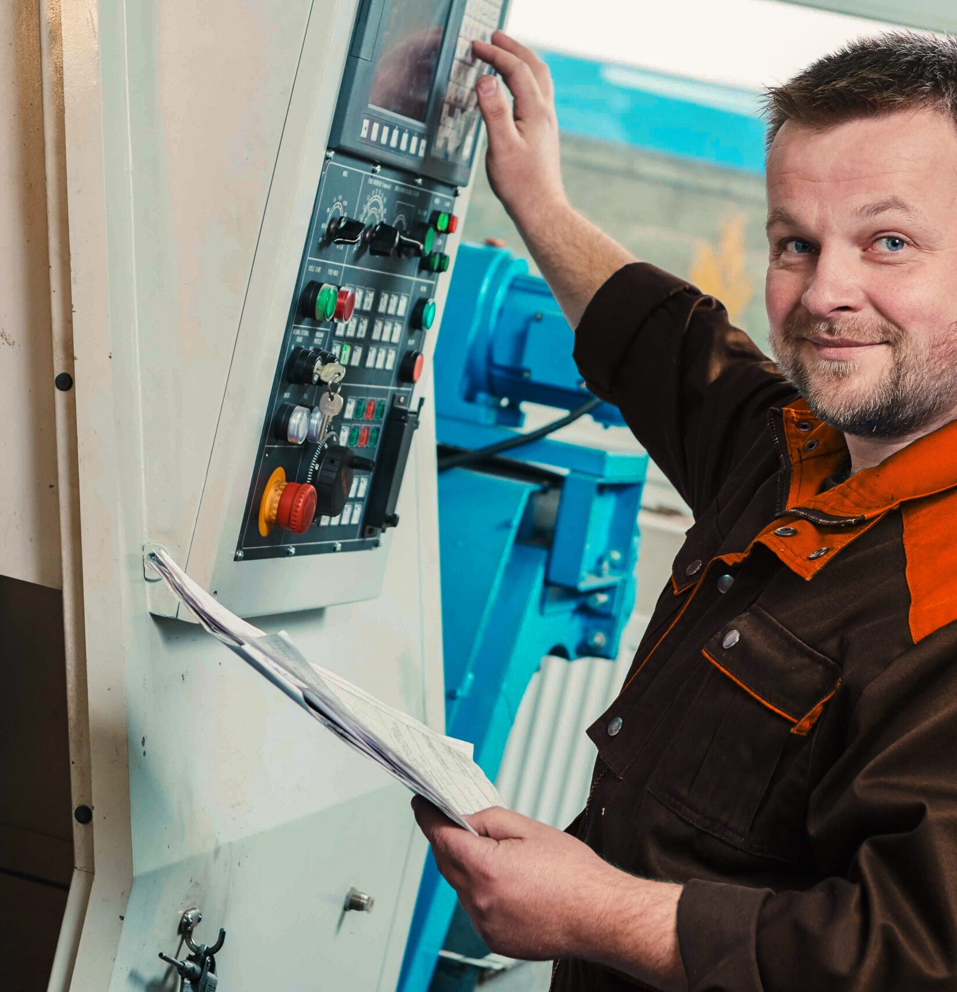
Prodieco: AI-Driven Innovations in CNC Programming and Maintenance
The AI-enhanced system developed by FactoryXChange has revolutionised how we access information, significantly reducing errors and optimising our processes. We're excited to continue refining this innovative tool to enhance our manufacturing operations further." – Prodieco Maintenance Team.
Client Name: Prodieco, Dublin, Ireland
Sector: Pharmaceutical
Duration of service provision: August 2024 – November 2024
Costs of services provided: 61k
The Challenge
Knowledge Management: Maintenance engineers needed rapid access to specific information in extensive CNC machine manuals, which often led to delays and inefficiencies.
Operational Hurdles: Technicians spent up to 45% of their time retrieving data, impacting productivity.
The Solution
AI-Driven Knowledge Retrieval Prototype: FactoryXChange (FxC) developed a Retrieval-Augmented Generation (RAG) prototype powered by Large Language Models (LLMs).
Capabilities: The system indexed over 20 product manuals, retrieving contextually relevant data using advanced AI algorithms.
Interactive Features: It provided direct, query-based access to solutions, eliminating the need for manual searches.
Impact/Outcome:
Efficiency Gains: Reduced information retrieval time from 20-30 minutes to just a few minutes, improving productivity tenfold.
Enhanced Decision-Making: Accurate and timely responses improved troubleshooting and operational outcomes.
Future Potential: Feedback-driven enhancements, such as integrating user profiles and multimodal query support, promise further optimisation.
Notes:
To give you a real-world example of how FactoryXChange is making an impact, let’s look at a case study from Prodieco, a company specialising in CNC programming and maintenance."
The Challenge: "Prodieco’s maintenance engineers faced a major challenge: they needed quick access to information from CNC machine manuals, but these manuals were extensive and hard to search through efficiently. As a result, technicians were spending up to 45% of their time just retrieving information instead of focusing on productive tasks."
The Solution: "FactoryXChange stepped in and developed an AI-powered knowledge retrieval system using a technique called Retrieval-Augmented Generation (RAG). This system:"
Indexed over 20 CNC machine manuals to allow instant, context-based searches.
Used AI to provide quick, relevant answers instead of forcing technicians to dig through pages of text.
Offered an interactive, query-based solution that eliminated manual searching altogether.
The Outcome: "This solution led to massive efficiency gains – cutting information retrieval time down from 20-30 minutes to just a few minutes. That’s a tenfold improvement in productivity."
"More than just saving time, it improved decision-making and troubleshooting, giving maintenance engineers the right answers, at the right time, with minimal effort."
"And this is just the beginning. Future enhancements will integrate user profiles and multimodal query support to make the tool even more powerful."
"This is exactly the kind of impact FactoryXChange aims for – providing real, measurable improvements that help businesses work smarter, faster, and more efficiently."

Slide 5
Why our work is important:
… it enables the acceleration of digital transformation, pushing boundaries for the betterment of people, communities and the planet.”
© FactoryXChange 2025
Notes:
We know that digital transformation can feel overwhelming, especially for SMEs. That’s why our approach is built around:" ✅ Discounted services – So you can access support when it matters most. ✅ Tailor-made solutions – Customised to your business’s specific needs, whether it’s guidance, prototyping, or skills development. ✅ Timely, on-demand support – Quality-assured services that minimise risk and maximise impact.
"Our mission is simple: to make digital transformation accessible, effective, and results-driven. And we’re here to support you every step of the way."

Slide 6
Current Service Page Demo
FactoryXChange (FXC) External Service Provider (xSP) Orientation Session Series Part 3
© FactoryXChange 2025 |
6
Notes:
How Easy It Is to Book a Service – Speaker’s Script
Slide: Booking a Service on FactoryXChange.ie
"One of the most common challenges businesses face is knowing where to start with digital transformation. It can be overwhelming to navigate funding options, technology choices, and training opportunities."
"That’s exactly why we built FactoryXChange—to serve as a one-stop-shop for digital transformation. Whether you’re an SME looking to streamline operations or a Public Sector Organisation exploring AI and automation, our platform connects you to the right expertise, training, and digital tools—all in one place."
Step 1: Explore Our Services
"The first step is simple—just visit FactoryXChange.ie. Our online hub is designed to be clear, accessible, and easy to navigate, so you can quickly find the services that match your needs."
"From skills training and AI-powered solutions to risk-free technology trials, we offer tailored options to help you adopt digital tools with confidence."
Step 2: Connect with a Digital Strategist
"Next, if you’re unsure where to start, you can speak directly with one of our Digital Strategists. These experts will take the time to understand your challenges and match you with the best solutions—whether that’s funding support, training, or technology trials."
"We know that every business is unique, so this personalised approach ensures that you’re not just adopting technology for the sake of it—you’re investing in the right tools to drive real business impact."
Step 3: Test Before You Invest
"One of the biggest concerns for businesses is risk. You might be wondering—what if the technology isn’t the right fit? That’s why FactoryXChange offers a Test Before Invest model. This means you can trial digital solutions risk-free before making a long-term commitment."
"Whether you’re looking at AI-driven automation, data analytics tools, or robotics, our platform allows you to experiment, learn, and make informed decisions—without unnecessary financial risk."
Step 4: Transform with Confidence
"Once you’ve selected the right solutions, you’ll have continued support from our team to help you implement and optimise your digital strategy."
"We don’t just connect you with technology—we help you use it effectively to create lasting business growth."
"And as your digital journey progresses, you’ll also have access to a growing network of businesses and experts who are navigating similar transformations, so you can share insights, success stories, and lessons learned."
Final Call to Action
"Since launching, a significant number of businesses have already booked services through FactoryXChange.ie—and many have gone on to see measurable improvements in efficiency, cost savings, and innovation."
"So, if you’re ready to explore what’s possible, I encourage you to visit FactoryXChange.ie today. Take a look at the services available, book a consultation, or just reach out to start the conversation."

Slide 7
Connect with us today
Discounted Services
To help at crucial moments in your digital innovation journey
Timely Support
That is on demand and quality assured to minimise investment concerns
Tailor-Made Offering
Designed around you… wayfinding, prototyping, learning, innovating…
Since October 2023 over 80 clients have booked services and support on FactoryXChange.ie

