Slide 1


The National Enterprise Hub
Delivering for SMEs. Delivering on policy.
Mark Atterbury
Enterprise Ireland
March 11th , 2025
www.neh.gov.ie

Slide 2








Delivering on policy
Assist businesses with decarbonisation
(Climate Action Plan)
Create single source for all SME supports
(SME taskforce (of 2021) recommendation)
Assist businesses with digitalisation
(Harnessing Digital Ireland Framework)
Accelerate business innovation
(Impact 2030)
Strengthen Irish-owned export sector
(Whitepaper on Enterprise 2022 - 2030)
Expansion of LEO mandate
(LEO Policy Statement 2024)

Slide 3





Research on SME needs
Complex business environment
Low take up
of green & digital supports
Lack of
time and engagement
Need for practical
support

Slide 4

Extensive Collaboration – New Support’s 24 Government Agencies

Slide 5


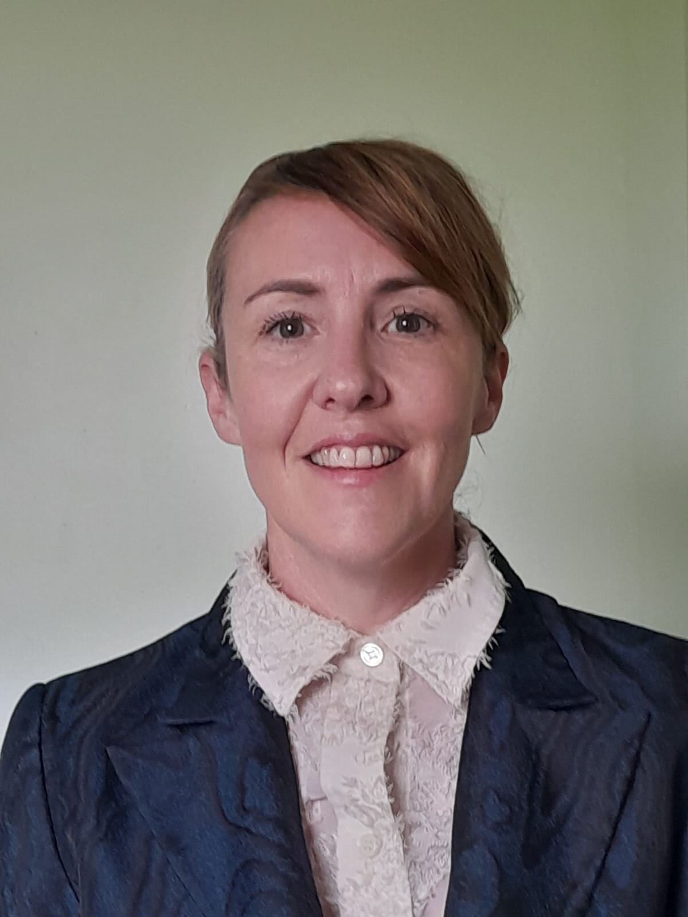

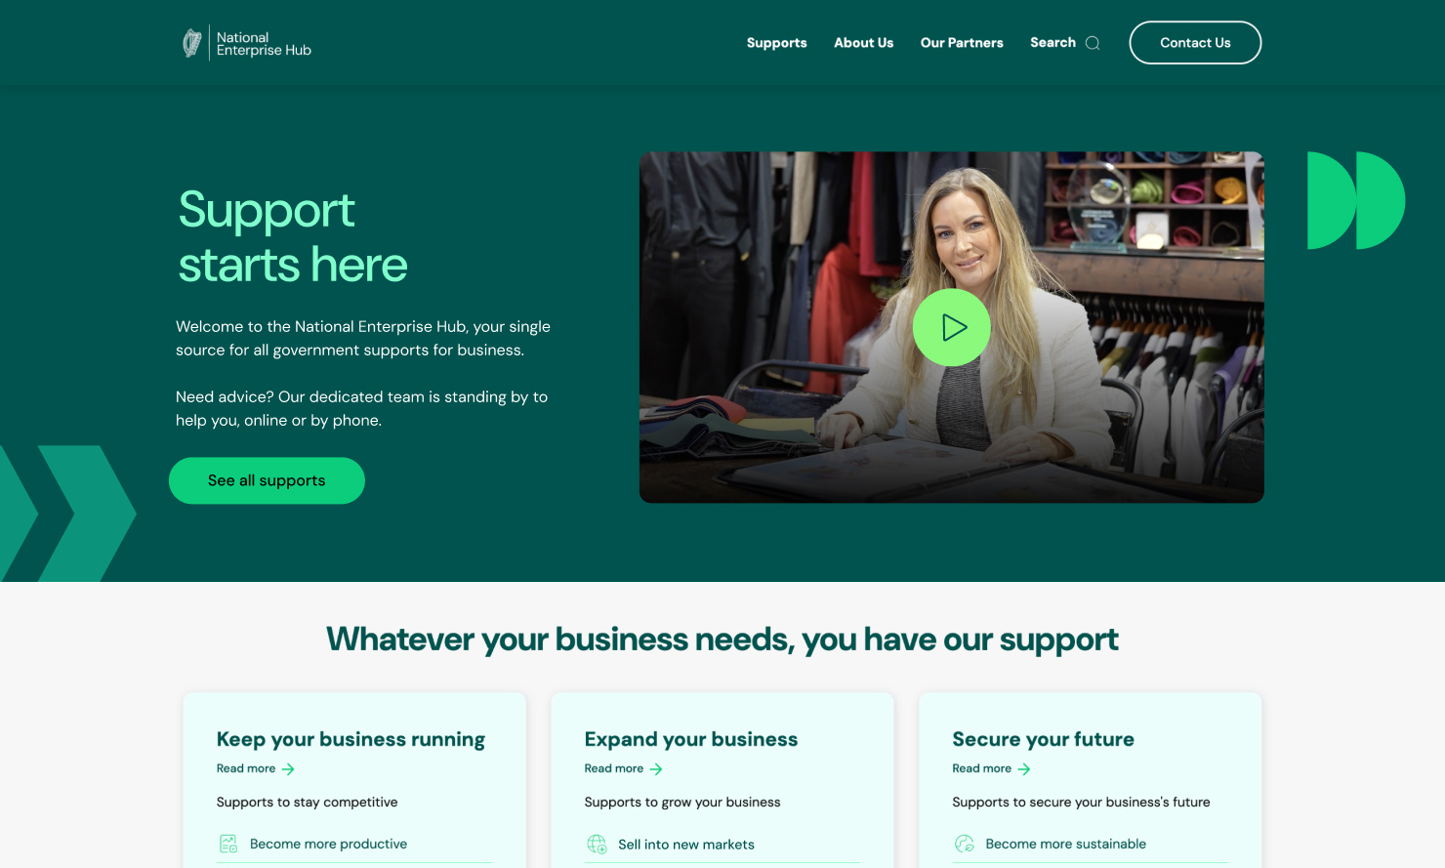





240 supports and a dedicated team, all in one place and 23 partners
Conor O'Donovan
Head of National
Enterprise Hub
Ciara Horgan Roca
National Enterprise Hub
Manager
Bridgin Durnin
National Enterprise Hub
Advisor
Tara Broderick
National Enterprise Hub
Hub Advisor
Niall McKeon
National Enterprise Hub
Advisor
Niamh Hughes
National Enterprise Hub
Assistant
Alice Solcan
National Enterprise Hub
Assistant
Notes:
240 Supports and a dedicated team – contact clients by phone, chat and email, our site was built on and delivered with SME user in mind,
Really looking at engaging on the goal.

Slide 6



Client Journey – Grow Digital
Mortgage/Finance Company
5-9 Employees
Goal of Business – Become more digital
Grow Digital Voucher, Sustainably, Lean for Business, Micro Qualification Marketing Digital Course
Niall McKeon
National Enterprise Hub
Advisor

Slide 7
Improve access to supports
Notes:
Top Query Types : LEO, Department of Agriculture, SEAI
Top Supports : Get support to expand, get help with cashflow, become more digital.

Slide 8
Thank you
www.neh.gov.ie

