Slide 1
Building
Competitiveness
Through
Digital Skills
Chantelle Lamont
Development Advisor, Skillnet Ireland
11th March 2025
Notes:
Good morning all, my name is Chantelle Lamont Development Advisor with Skillnet Ireland.
This morning I am here to speak to you about some of the opportunities available to you through Skillnet Ireland Networks specifically around Skillnet Ireland Digital Skills Programme offerings – just before I will give an overview of Skillnet Ireland for anyone that is not familiar with us.

Slide 2
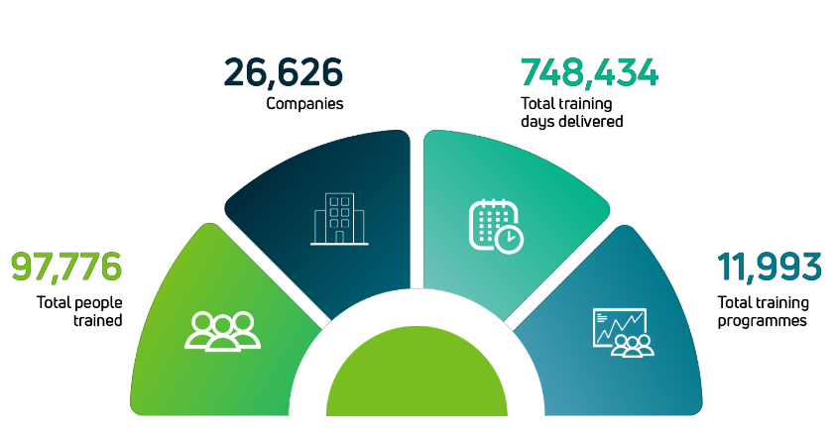
Skillnet Ireland
Skillnet Ireland – Context and Strategic Focus
Our Approach
For business - by business.
Skillnet Ireland is the national skills development agency of Ireland. In partnership with industry, we offer upskilling programmes and business supports to companies of all sizes.
Fundamental to our success is our enterprise-led approach.
Notes:
Skillnet Ireland is the national talent development agency of Ireland. As you can see here in the diagram we work in partnership with industry, HEIs and Government agencies we offer upskilling programmes and business supports to companies of all sizes.
Skillnet Ireland Networks are listening to businesses around the area, talent skills requirements, as well as challenges businesses are facing.
Our key strategic focus areas include providing industry with tools, frameworks and talent to support Digitalisation, Sustainability, SME Productivity, Innovation and FDI Talent also.
In 2023 we supported over 97 thousand trainees and over 26 thousand companies across various industries delivering just under 12 thousand programmes.

Slide 3
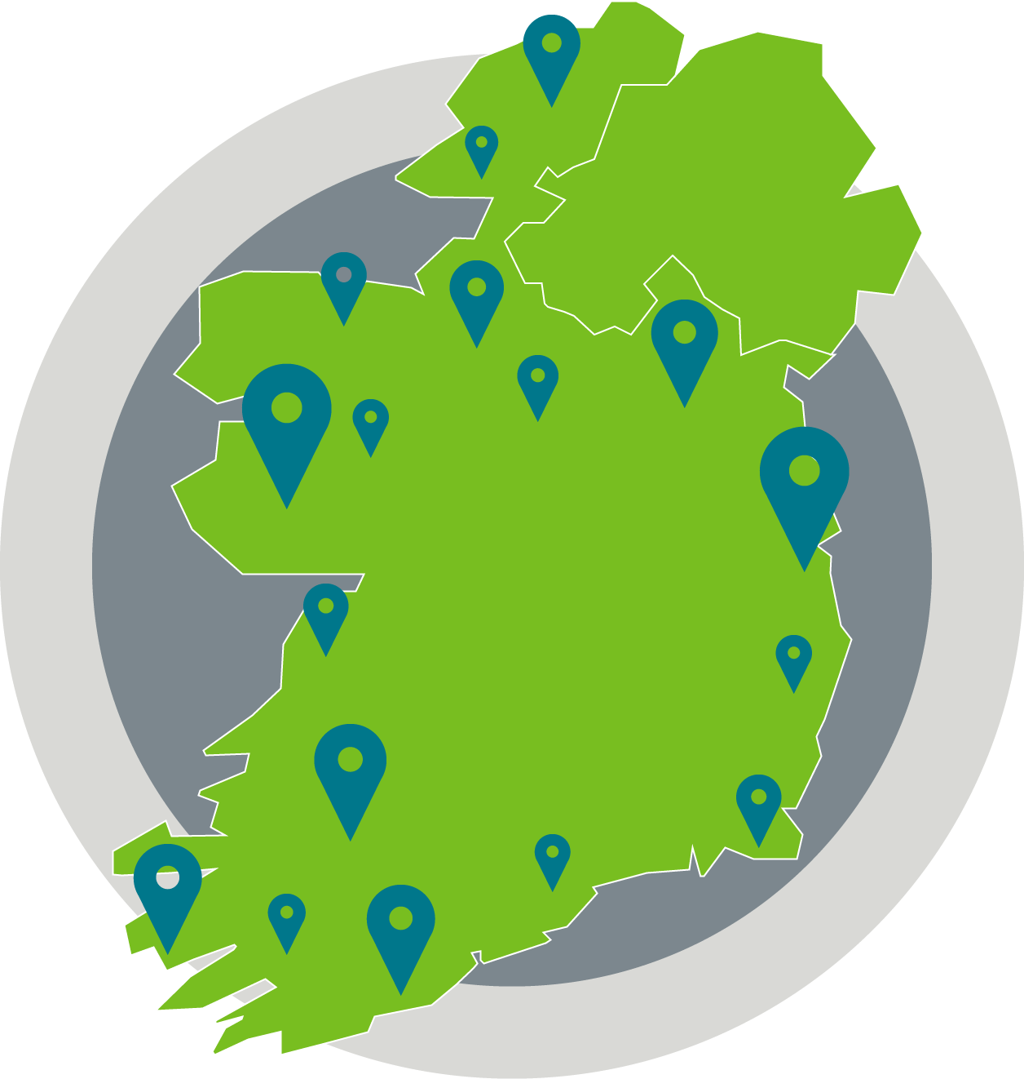
Skillnet Ireland
Skillnet Ireland – Context and Strategic Focus
Skillnet Ireland operates through sectoral and multi-sectoral regional networks in Ireland.
Sectors
Agriculture
Aviation / Aerospace
Biopharma / Medtech
Business Services
Design / Media / Audiovisual
Digital Technology
Engineering / Construction
Financial Services
Food / Beverage
Green Economy
Healthcare
Hospitality / Tourism
Manufacturing / Supply Chain
Retail
Notes:
To give you a sense of the span of delivery, we have 69 Skillnet Networks which are both Regional Networks delivering multi-sector training as well as our Sectoral Networks delivering industry-specific training in agriculture, BioPharma, Hospitality, Manufacturing, Retail and Technology which we will look at more closely.

Slide 4
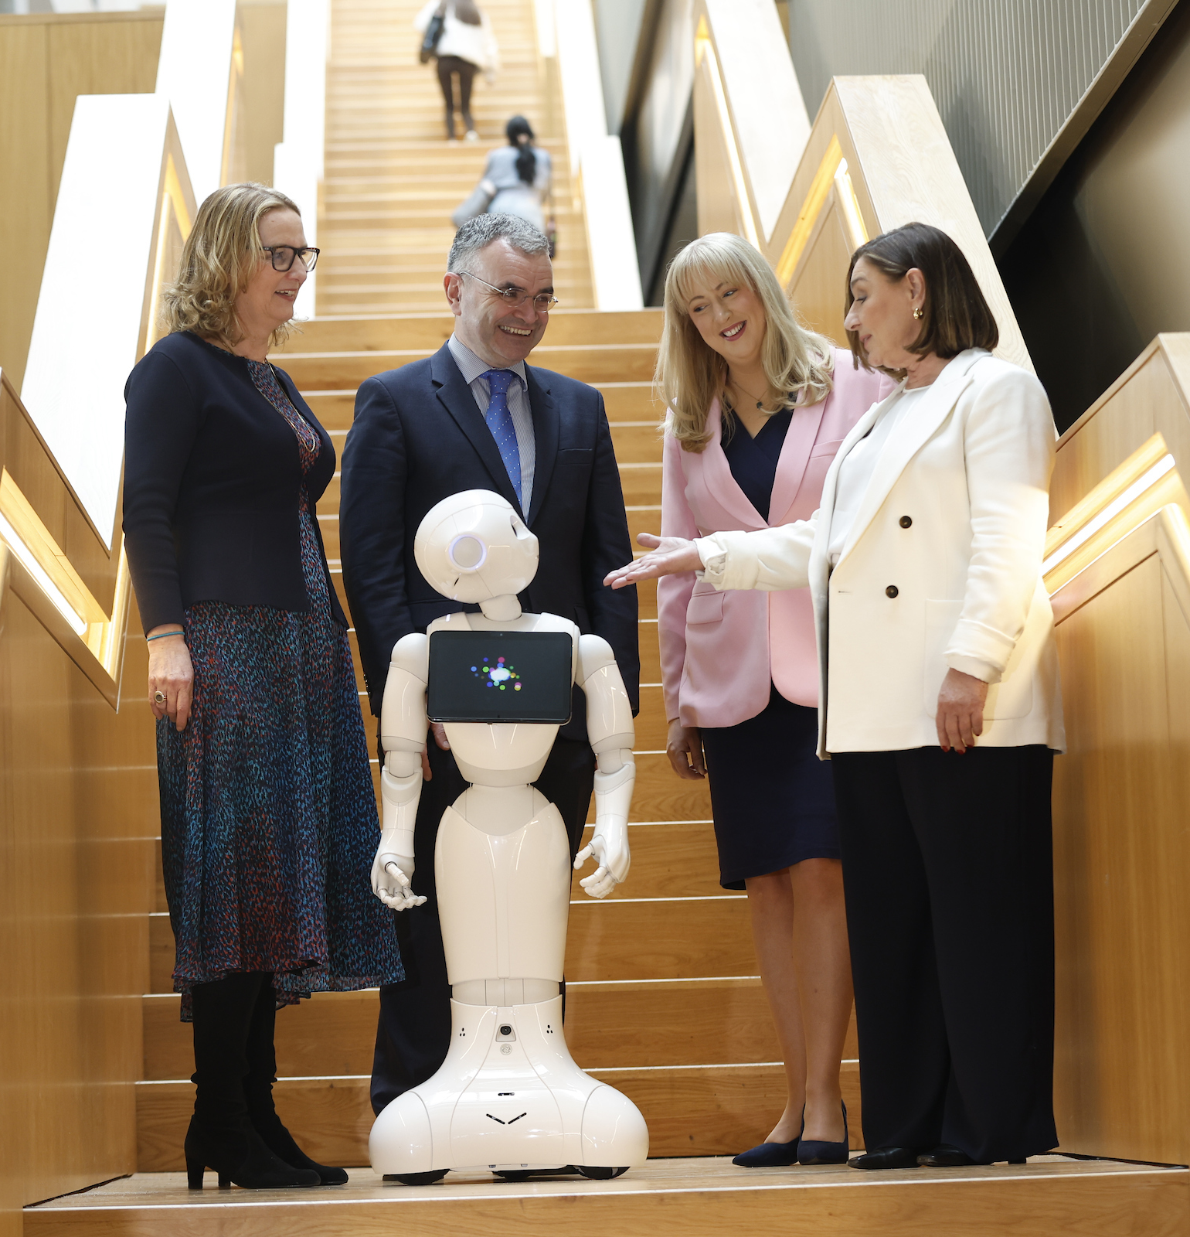
Skillnet Ireland
Skillnet Ireland – Context and Strategic Focus
Building Competitiveness Through Digital Skills
In partnership with industry, we offer upskilling programmes and business supports to companies of all sizes. Digital Skills offerings include;
Digital Innovation, Transformation & Leadership
Automation, Digital Manufacturing and Robotics
Digital Sales and Marketing
Software, Development Ops & Technical Skills
Emerging Digital Technologies
Data Analytics
Cybersecurity
Notes:
In an era defined by AI, rapid digital transformation, and constant change, the way we do business and lead teams is evolving.
It requires a new mindset and approach, but it’s not always clear what this should be. Our Skillnet Ireland Business Networks are building competitiveness through Digital Skills programme offerings are enterprise led – whereby we identify skills gaps and collaborate closely with businesses in each industry and region.
These include
Digital Innovation, Transformation and Leadership programmes
Automation, Digital Manufacturing and Robotics
Digital Sales and Marketing
Software, Development Ops & Technical Skills
Emerging Digital Technologies
Data Analytics
Cybersecurity

Slide 5
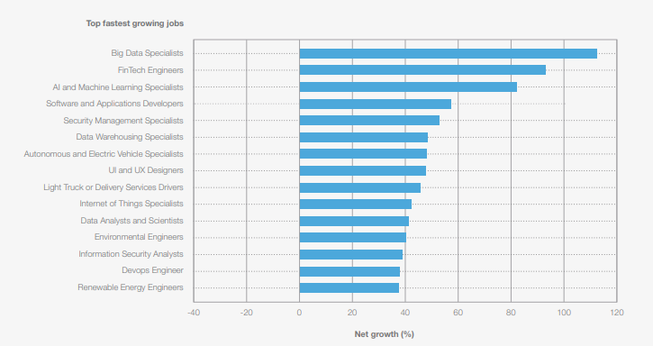
Skillnet Ireland
Skillnet Ireland High Level Outputs 2023
Fastest Growing Jobs 2025 -2030
Notes:
As many of you here today are running your own businesses it is no surprise to you that the way we are working has changed dramatically over the past 5 years. And this is continuing to evolve at a rapid pace. With new roles emerging and more demand for certain talent and skills. This is an extract from The World Economic Forum – Future of Jobs Report 2025 outlines the fastest growing and fastest declining jobs over the next 5 years.
I have highlighted a few positions where we can see Technology is having an impact. Big Data Specialists, Ai Machine Learning, Software and App Developers… the list goes on.
While technology trends partly contribute to the growth of security-related roles such as Security Management Specialists, with more data collection across businesses other contributing factors include increased geopolitical fragmentation.

Slide 6
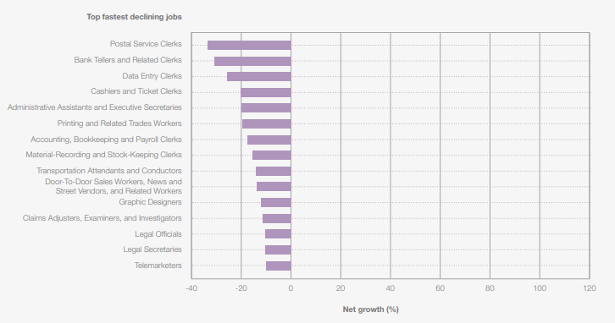
Skillnet Ireland
Skillnet Ireland High Level Outputs 2023
Fastest Declining Jobs 2025 -2030
Notes:
By contrast, it is worth noting the fastest declining roles which are anticipated. These include various clerical roles, such as Cashiers and Ticket Clerks, alongside Administrative Assistants and Executive Secretaries, Printing Workers, and Accountants and Auditors. Broadening digital access, and autonomous systems are the primary drivers for this decline.
This is why lifelong learning is so important to ReTRAIN and ReTAIN staff members, and ensure we move with the pace of this change.

Slide 7
Skillnet Ireland
Skillnet Business Networks
Through our 69 Skillnet Business Networks, we partner with further and higher education to create and deliver unique programme offerings.
Education Partners
Post Graduate in Sports Analytics, Technology & Innovation
from Technology Ireland Digital Skillnet
MSc Sports Analytics, Technology and Innovation
from Technology Ireland Digital Skillnet
Certificate in Foundations of Artificial Intelligence
from Technology Ireland ICT Skillnet
MSc in Cybersecurity
from Technology Ireland ICT Skillnet
Post Graduate Diploma in Artificial Intelligence
from ITAG Skillnet
Notes:
A high level overview of some of the programmes currently being offered by some of our Skillnet Business Networks;
Include a focus here on the emerging trend in Sports Analytics Technology Ireland Digital have partnered with TU Dublin offering both Post Graduate and Masters in Sports Analytics, Technology and Innovation
Technology Ireland ICT have the much in demand certificate in Foundations of AI. And I know they also have a partnership with TUS and LM Ericsson where for over a decade we have been bringing new software engineering talent into the region and the value that brings in support of the surrounding areas/community etc. This engagement starts with the Skillnet Ireland-supported Level 8 Certificate in Software Engineering and leads to a Level 9 Masters in Software Engineering. It is free and on successful completion, participants are employed in the LM Ericsson Corn-A-Maddy Campus.
ITAG based in Galway also have a Post Graduate Dipolma in Artificial Intelligence with University of Galway.
Most of these programmes I am mentioning today are hybrid blended delivery which make them accessible to many.

Slide 8
Skillnet Ireland
Skillnet Business Networks
Skillnet Business Networks
Education & Training Partners
Digital Test & Measure CPD
from MIDAS Skillnet
Certificate in FX for Film & TV
from Creative & Cultural Industries Skillnet
IT Leadership Programme
From Tech Industry Alliance Skillent
Notes:
Again I know we have a variety of industries here today so again to give a sense of the span we have MIDAS the semiconductor Industry. Creative and Cultural Industries with FX for Film and TV with TUShannon – this is an industry which has gone from strength to strength over the last number of years thanks to technology, subscription tv, our talented workforce and the beautiful Irish landscape making it a go-to destination for filming and production.
As well as offerings which include IT leadership and Change Management programmes which are applicable to many businesses even if you are not directly a technology organisation.

Slide 9
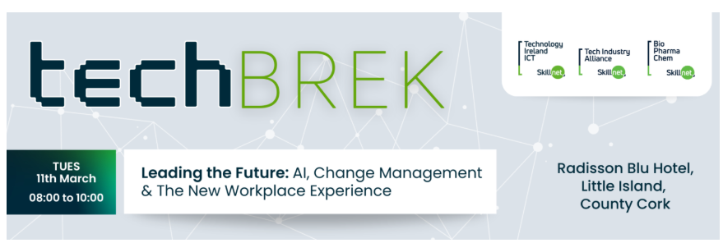
Skillnet Ireland
Skillnet Ireland High Level Outputs 2023
Business Networking & Knowledge Sharing Events
AI, change management & the new workplace experience
In-person techBREK event in Cork brings together leaders and change-makers from the tech, innovation, and biopharma industries to explore how to effectively navigate this new landscape. Discover actionable strategies for leading with agility, fostering innovation, creating a positive organisation culture as you guide your team through workplace transformation.
Notes:
Skillnet Ireland Networks are not just training, we aim to support businesses in various ways which also include events, and conferences for Businesses Networking and knowledge sharing.
I have just selected one sample here which is actually taking place today in Cork.
However, Technology Ireland ICT Skillnet have also started hosting a range of 'free to attend' events around the country including our techBREW and techBREK series which, along with excellent speakers, are a great way for businesses to network and share knowledge. Register for their newsletter and you will be kept up to date with any events and training opportunities.

Slide 10
Skillnet Ireland
Skillnet Business Networks
Skills Connect offers free training programmes and enterprise-led job placements to unemployed individuals. This initiative offers individuals the opportunity to develop new skills, build confidence and access practical on-the-job training.
Programmes include:
Future in Tech – Technology Ireland ICT Skillnet
Womens Reboot – Technology Ireland Digital Skillnet
Full Stack Software Development Programme – Tech Industry Alliance Skillnet
Cyber Security Analyst Bootcamp – ITAG Skillnet
Animation, Games & VFX Traineeship – Cultural & Creative Industries Skillnet
Notes:
Many of our Networks deliver Skills Connect programmes which are free training programmes with enterprise led job placements to unemployed individuals.
Here are some of the Technology programmes which include Future in Tech, Women Returner Programmes like Womens Reboot, Software Development, Cyber Security as well as other areas suchas Animation and VFX training.
These programmes are designed to develop new skills, build confidence and access practical on the job training.

Slide 11
Discover more about how Skillnet Business Networks and National Initiatives can advance your business competitiveness
www.skillnetireland.ie
Notes:
I hope I have given you a sense of the opportunities, training programmes that are out there to support you and your business on this Tech Journey.
And I have more details brochures with list of full programmes available – if you would like to speak to me at the break.
You can see the link to our website which also has the list of all 69 Skillnet Ireland Networks and contact details.
Thank you for listening and hopefully I will catch up with some of you over coffee.

