Slide 1


FIT Technology
Apprenticeships
Your Talent Pipeline
Notes:
Good Afternoon and welcome to todays Tech Apprenticeship Webinar- the focus for today will be to introduce you to FIT and our tech Apprenticeships programmes with a focus on Cybersecurity Tech apprenticeships. Please feel free to add Questions to the chat and we can have a Q & A at the end of the presentation.

Slide 2


Introduction to FIT and its
​FIT Mission: is to promote an inclusive sustainable Smart Economy by creating routes to marketable technical skills for job seekers and career changers wishing to pursue quality professions in Ireland’s thriving digital economy, thereby enabling greater diversity and inclusion.
Transformative Potential
01
02
Tech Apprenticeships
Various Fields
Cybersecurity Apprenticeship ​
Computer Networking Apprenticeship ​
Software Development Apprenticeship ​
Data Analytics (Autumn 2025)
Advanced Manufacturing Level 4 traineeship and White Goods Service Technician Level 6 as part of the Circular Economy Skills Initiative.
03
04
Learning & Upskilling
Community Engagement
Develop IT and other transferable in-demand skills through our online platforms provided by IBM, Microsoft, LinkedIn, Accenture & Google.
Foster an interest in tech at earlier stages & build on our tech talent pipeline in schools. We also provide Digital literacy and Homeless initiatives. ​
Notes:
FIT or Fastrack into information technology is an NGO established in1999 with over 25 years experience working with organisations within the tech sector.
Mission:
​FIT is a representative organisation of the technology sector committed to growing Irelands tech talent pipeline through skill needs analysis and programme development.

Slide 3

















An Industry Initiative:
Tech Talent Development
By leveraging FIT’s expertise in tech upskilling and reskilling, companies can effectively bridge the skills gap, ensuring a steady pipeline of qualified candidates ready to meet the challenges of today’s digital economy.​
By 2030, it is predicted of the global workforce:
59%
Will require training.
29% could be upskilled in their current roles,
19% could be upskilled and redeployed elsewhere within their organization,
11% would be unlikely to receive the reskilling or upkskilling needed, leaving their employment prospects increasingly at risk.
85%
Of employers will prioritise upskilling their team.
70% of employers expecting to hire staff with new skills.
40% planning to reduce staff as their skills become less relevant.
50% planning to transition staff from declining to growing roles.
(Future of Work Report 2025)

Slide 4



How do we do this?
By Closing the Skills Gap.
Skills Need Analysis
We identify the most relevant skills required to succeed in the modern workforce, such as proficiency with Generative AI, and build them into each of our training programmes.
FIT coordinates wider access to tech skills training, leading to exciting career paths and employment opportunities for all those who have a curiosity and passion for technology.​
Our tech apprenticeships are based on an earn-while-you-learn working model, where apprentices gain skills through off-the-job training and apply those skills in the workplace. This allows them to gain relevant working experience during their studies and build a successful career early on.
Diversity & Inclusion Initiatives
Promote inclusive best practices through community and cohort initiatives such as our IFIT and Cuimsiú programmes.
Industry Partnerships
Collaboration with Ireland’s leading technology companies and educational bodies to meet industry standards.
Notes:
The Cuimsiú (kwim-shoo) (means inclusion) programme is a new initiative by FIT to support neurodivergent and disabled tech enthusiasts on a path to tech employment, including tech apprenticeships.
We also work with employers to support them to create inclusive workplaces through our employer network.
We will have a webinar on the 25th of February for anyone who might be interested in joining the programme this year. Keep an eye on our social media for this!

Slide 5

How do we do this?
By Closing the Skills Gap.
Upskilling
You can nominate internal staff to complete the tech apprenticeship training with access to all the same benefits including government grants.
FIT coordinates wider access to tech skills training, leading to exciting career paths and employment opportunities for all those who have a curiosity and passion for technology.​
Our tech apprenticeships are based on an earn-while-you-learn working model, where apprentices gain skills through off-the-job training and apply those skills in the workplace. This allows them to gain relevant working experience during their studies and build a successful career early on.
Recruitment Offering
Candidates for FIT Tech Apprenticeships go through a rigorous process, including an aptitude assessment and interview, before meeting with any employers.
Accessibility
We provide free services and resources to both Tech Apprentices and Employers to ensure everyone has equitable access to quality employment.

Slide 6

Tech Apprenticeship Programmes:
Trusted, fully accredited apprenticeships.
FIT is the National Coordinating provider for Tech Apprenticeship programmes with statutory responsibility for Quality Assurance, Governance and Operational Management.​
Upon the completion of the programme, Apprentices attain a Quality and Qualifications Ireland-accredited (QQI) Advanced Certificate, which is placed at Level 6 on the National Framework of Qualifications.
Software Development
Cybersecurity
Computer Networks
A software developer, also known as a computer programmer, builds and tests high-quality code across front-end, logic and database layers.
Cybersecurity associates keep data safe. In a digital society, it is critical that apprentices understand how networks are created, the flow of data, and how it can be kept secure.
A computer networking associate/specialist designs, installs, maintains and supports communication networks within and between organisations.

Slide 7







How does it work?
What do you need to know as an Employer?
We will go through an overview of FIT Tech Apprenticeships including the programme structure, onboarding, costs associated, and some of the benefits to becoming a Tech Apprentice Employer.
Structure
Onboarding
Curriculum
Length of the programme and type of delivery.
Steps in the registration process.
Recent updates to our curriculum to meet today’s workforce demands.
Expectations
Costs
Results
What is expected of a Tech Apprentice Employer?
Are there any costs associated with the programme?
What outcomes can you expect to achieve?

Slide 8
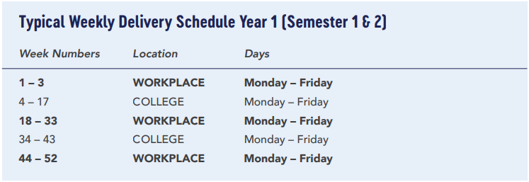
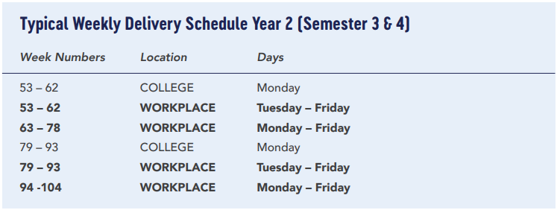
Typical Programme Structure
Length of programme: 2 years (4 semesters)
70/30 split.
College training type: In person OR virtual classroom
FIT provides a free recruitment service which includes sourcing candidates and preparing them for interviews with the employer.
Candidates submit their CVs, go through an eligibility check, interview with a FIT team member, and complete an aptitude test, all before seeing an Employer.

Slide 9
MAR
NOV
FEB
SOFTWARE DEVELOPMENT
DATA ANALYTICS**
IN PERSON - SLIGO
2025
IN PERSON DUBLIN
2025
IN PERSON - DUBLIN
2025
APR
NOV
FEB
CYBERSECURITY
SOFTWARE DEVELOPMENT
IN PERSON - SLIGO
2025
IN PERSON - MAYO
2025
IN PERSON - ATHLONE
2025
2025
SEPT
SOFTWARE DEVELOPMENT
NOV
SOFTWARE DEVELOPMENT
2025
IN PERSON - SLIGO
2025
VIRTUAL - DUBLIN
Cohorts
SEPT
COMPUTER NETWORKING
NOV
CYBERSECURITY
2025
IN PERSON - CORK
2025
VIRTUAL - KERRY
SEPT
CYBERSECURITY
2025
IN PERSON – LOUTH
**Subject to QQI validation
Interested in taking on a full cohort?
Speak to us today and we may be able to accommodate your schedule & location!
Current schedules are subject to change.
SEPT
DATA ANALYTICS**
2025
IN PERSON - DUBLIN
OCT
SOFTWARE DEVELOPMENT
2025
IN PERSON - DUBLIN

Slide 10

Onboarding & Hiring
Employers are onboarded by completing a handful of steps including registering through the Solas website. FIT will assist you throughout this process and ensure you have all the resources you need to become a successful Tech Apprentice Employer.
Mentorship
A Mentor from your company is assigned to any apprentice you choose to employ. They will work closely with the apprentice to ensure a meaningful experience where the apprentice can thrive and actively contribute to your team.
Time & Resources
Feedback
FIT provides a free recruitment service of Tech Apprentices to provide you quality, pre-vetted candidates, eliminating time spent on recruiting processes.
Throughout the two-year programme, we maintain ongoing communications with your Mentor and other managers involved to make sure both you and your Apprentice are getting the most out of the programme.

Slide 11

€312-€408*
€4000+
€0
Per Week
Salary
(as a guide)
Government
Grants
Recruitment
Fees
*Year 1: €16,224 annual or €312 p.w.
*Year 2: €21,216 annual or €408 p.w​.
Cost-Effective Talent Solution
Off-the-job training costs are government funded through grants. ​
FIT manages all aspects of the programme and coordinates employer input.​

Slide 12
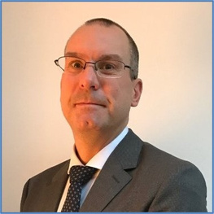



Positive Rates of Success
Improved Diversity, Equity, and Inclusion
Results
Across 3 programmes, 95% of tech apprentices have received full or partial awards. Even those who did not pass all exams were frequently kept on as full-time employees as they demonstrated excellent skills, knowledge, and understanding in the workplace.
Creating better access for quality employment stands at the heart of our mission. Our work has resulted in nearly a third of our applicants being female and hundreds using our resources for underrepresented communities such as IFIT, Choose Tech, and our Ukrainian Hub.
FIT Tech Apprenticeships are growing in scale with hundreds of apprentices and employers being matched each year, with an 89% retention rate.
Employer Testimonial
“The program has served as a valuable source of talent for our organization, with a high level of training & support provided to the apprentices. Deloitte see the Tech Apprenticeships as an investment to our business business as a way of progressing and
Employer Testimonial
“This programme brings increased diversity of experience and thinking and has enabled us to broaden our talent pool to shape the workforce we
cultivating industry specialists & professionals.”
we need to help clients succeed.”​
—Jamie Rickard
Director, Technology Consulting, Deloitte
—Hilary O'Meara
MD, Accenture Ireland

Slide 13
Roadmap for 2025:
Exciting changes this year.
We have many new and exciting changes being implemented this year including a brand new Data Analytics programme, integrating elements of AI into our curriculum, and changes to block scheduling and programme dates.
Data Analytics
(Autumn 2025)
Incorporating AI
(Current)
Cuimsiú Neurodiversity Programme (Current)
The new programme will allow apprentices to find trends and solve problems using data and a range of technologies, an essential skill in shaping businesses today.
Across all of our programmes, we have incorporated elements of Generative AI into our curriculum to continue developing the most relevant skills for today’s market.
Our new Cuimsiú programme provides tailored career support for neurodivergent and disabled people, while working with employers to create inclusive workplaces.
Notes:
The Cuimsiú (kwim-shoo) (means inclusion) programme is a new initiative by FIT to support neurodivergent and disabled tech enthusiasts on a path to tech employment, including tech apprenticeships.
We also work with employers to support them to create inclusive workplaces through our employer network.
We will have a webinar on the 25th of February for anyone who might be interested in joining the programme this year. Keep an eye on our social media for this!

Slide 14





Thank You!
Get in touch.
Jessica McKeown
Senior Tech Apprenticeship Officer
Connect with me on Linkedin!
(Link in the comments.)
086 815 7584
jessicamckeown@fit.ie
Apply on our website:
www.fit.ie

