Slide 1
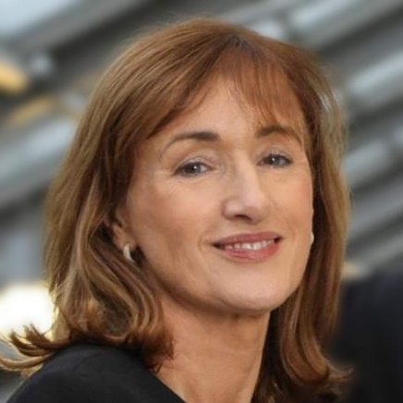

Mary Ryan
Deputy CEO, WestBIC
Lets Talk About Tech
Midlands ICT Network
11th March 2025

Slide 2
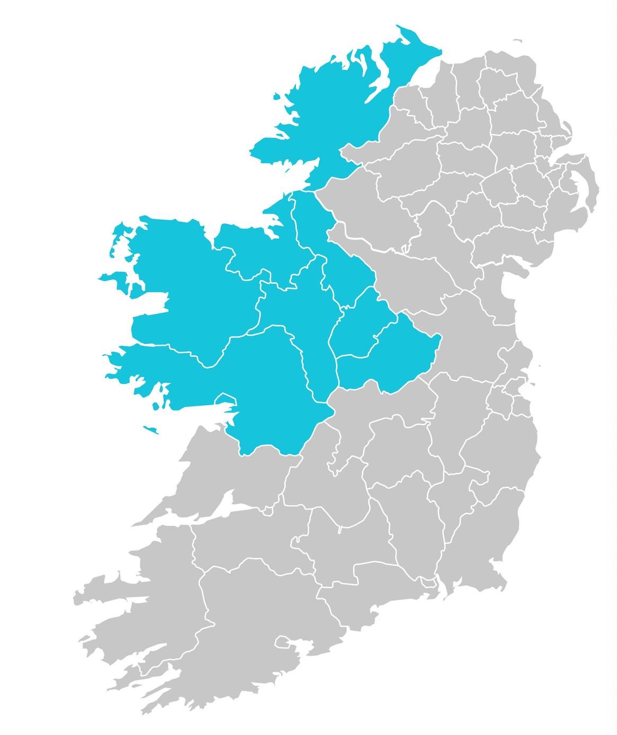



Who Are We?
Galway
Mayo
Roscommon
Westmeath
Longford
Sligo
Leitrim
Donegal
Tipperary
Offaly
Laois
Kilkenny
Carlow
Waterford
Wexford
Support clients throughout the company's life cycle - concept to commercialisation & on to become investor ready
The Official EU Business & Innovation Centre for Ireland’s Border, Midlands & Western Region
Regional Offices in Galway, Roscommon, Mayo & Donegal
Established in 1987

Slide 3


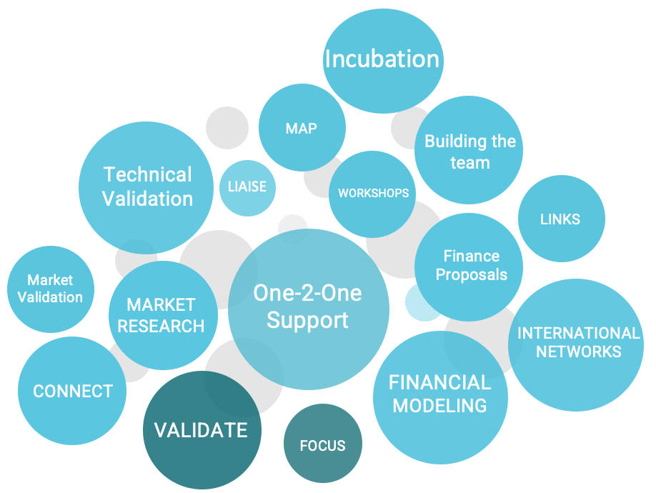



What We Do
One-2-One Investor Readiness
Network & Linkages
Detailed assessment of companies needs, incl. international market traction, planning & mapping progress with startups/scale-ups
Investor readiness preparation & identify pitch opportunities in Ireland & Internationally
Troubleshooting
Business Planning
Assist with HPSU/PSSF/Business Plan documentation, provide financial modeling templates and preparation of FDS
Troubleshoot problem areas especially in relation to commercial validation, sales pipeline etc
Pre Seed Support
Liaison with
Support Agencies
Provide tailored pre seed direction to companies on path to investor readiness, including virtual PSSF workshops & application support
Regular communication with
EI / WDC / LEO & other support organisations in relation to project progress

Slide 4
Enterprise Development Pathway
Managing & Funding the Progression Pathway
STEP 04
Become Investor Ready & secure HPSU and/or private funding - commercialization
STEP 02
Source early seed programmes
& feasibility funding - New Frontiers/LEO etc
Accelerator
HPSU
New Front
Comm Fund
Prep4Seed
PSSF
LEO / EI
STEP 03
STEP 01
Bootstrapping – concept/research to MVP
Source funding to develop product, validate market & progress to investor readiness (PSSF, Accelerators, Comm Fund, Prep4Seed etc)
Notes:
Commercial Validation remains the key issue in securing match investment and requires specific direction from the outset with client companies, focusing on securing a tangible sales pipeline that will stand up to investor DD.

Slide 5
Startup Challenges
Sourcing Skills/Talent
01
Difficult for startups to compete with larger Co’s & urban
locations when recruiting
Market Validation
02
Key element in developing a viable enterprise & attracting investors
Growth Funding
03
Start-up & growth funding is scarce & difficult to secure
Internationalisation
04
Going International - big challenge

Slide 6
Thank you
Mary Ryan
info@westbic.ie
www.westbic.ie

